Slide 1
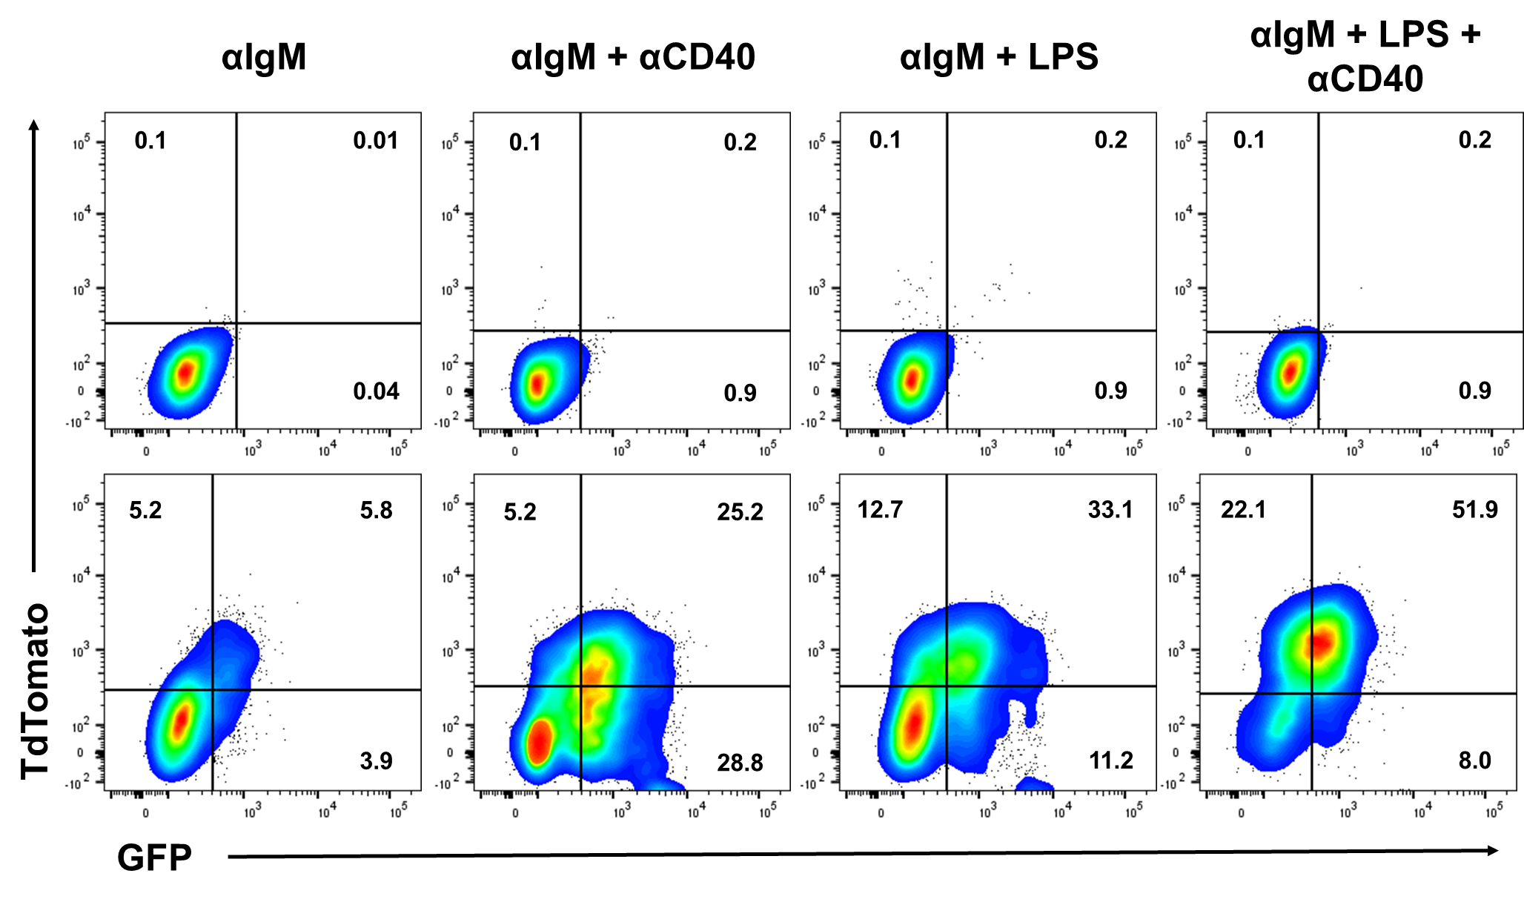
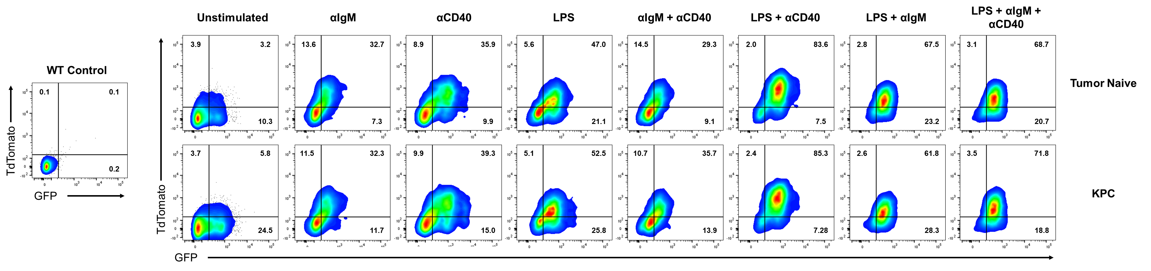
A)
B)
WT
CD1d^{Hi}CD5⁺
CD21^{Hi}
Il12a^{GFP}Ebi3^{Tom}
CD1d^{Hi}CD5⁺
CD21^{Hi}
C)
Supplementary Figure 1. Representative flow cytometry plots pertaining to data in Figure 1. A) WT and Il12a^{GFP}Ebi3^{TdTomato} CD1d^{Hi}CD5⁺CD21^{Hi} B cells stimulated with indicated conditions corresponding to Figure 1F. B.) Quantification of GFP⁺TdTomato⁺ B cells from (A). C) Representative flow cytometry plots for data in figures 1H, 1I.

Slide 2
A)
B)
Supplementary Figure 2. Immune profiling of non-tumor bearing MD4 and Cd19^{Cre/+}; Myd88^{Fl/Fl} mice. A) Frequencies of indicated immune populations isolated from spleens of healthy non-tumor bearing mice. B.) Frequencies of indicated B cell subsets isolated form spleens of healthy non-tumor bearing mice.

Slide 3
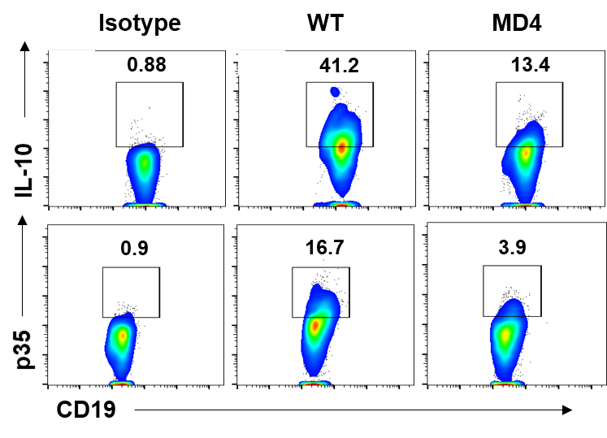
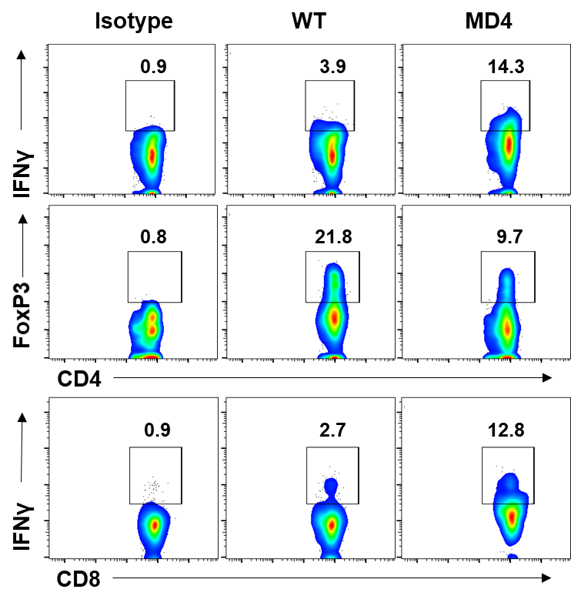
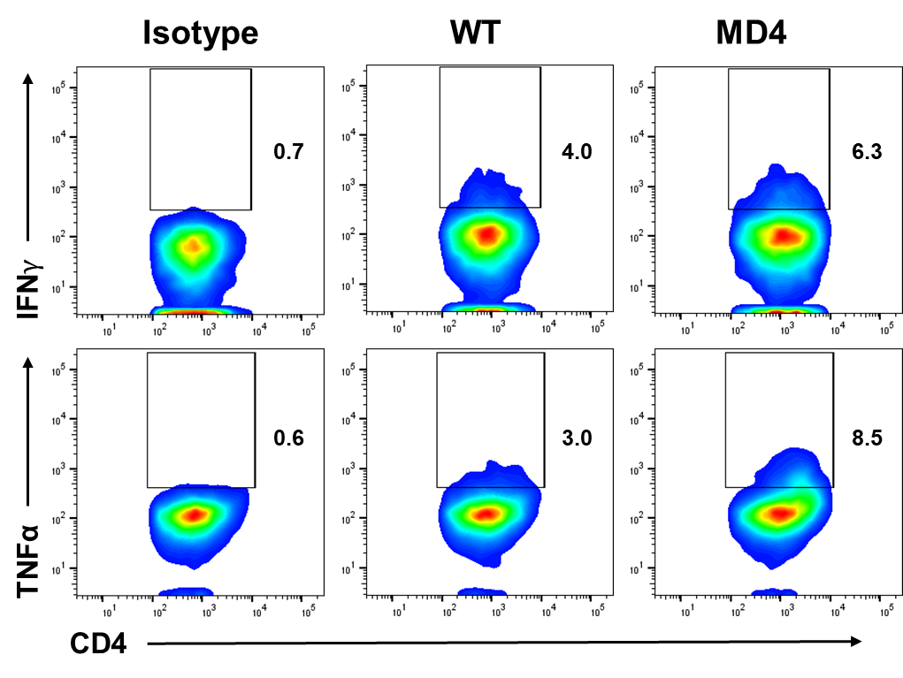
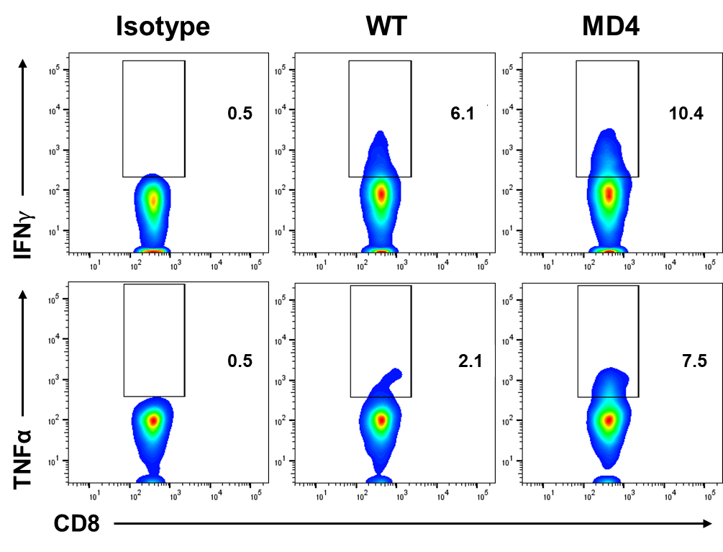
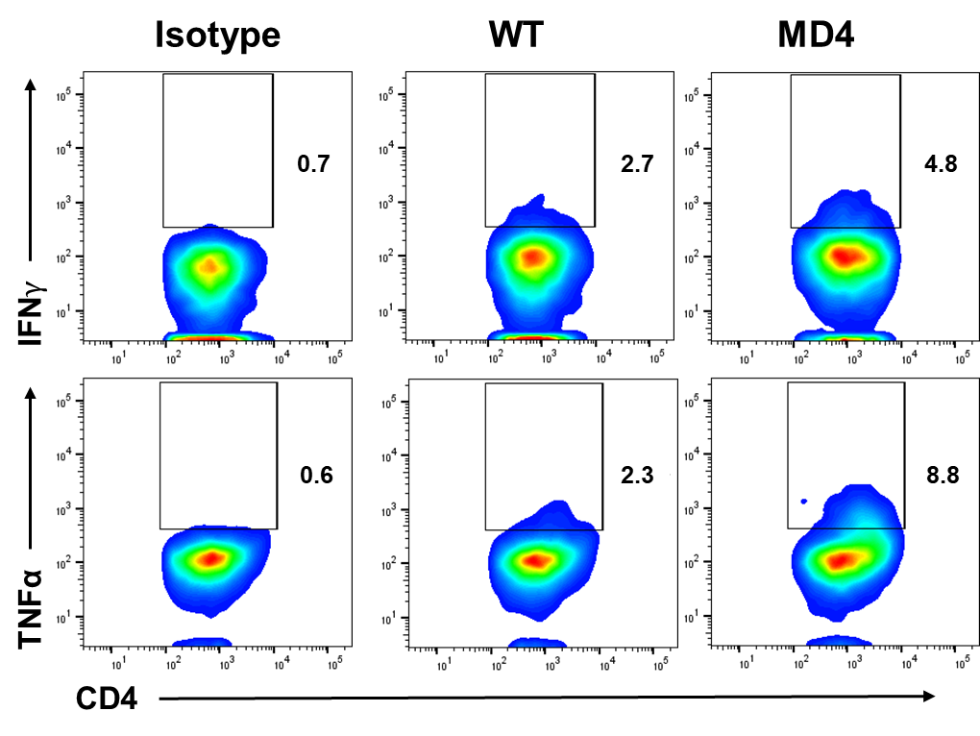
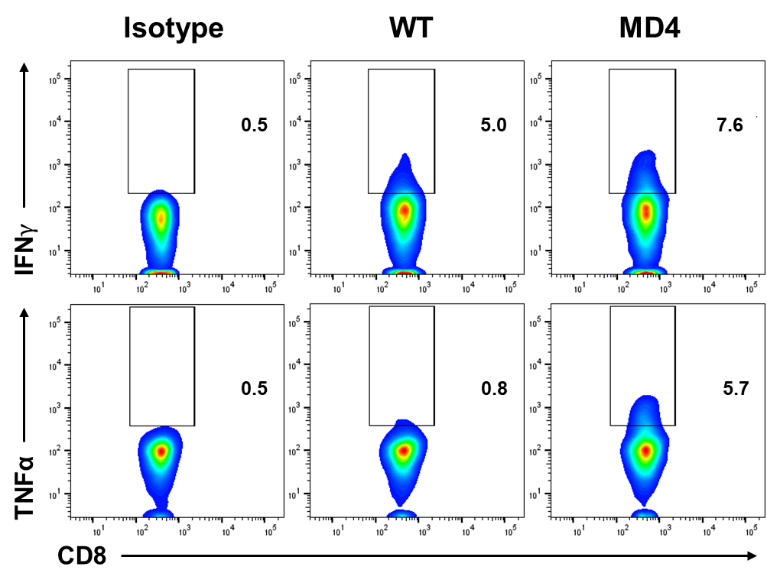
A)
B)
C)
D)
Supplementary Figure 3. Tumor-bearing MD4 mice display decreased regulatory B cell function and increased effector T cell function. A) Representative flow cytometry plots of tumoral B cells stained for IL-35 (p35) and IL-10. B) Representative flow cytometry plots of tumoral T cells stained for IFNy, TNFα, and FOXP3. C) Representative flow cytometry plots of splenic T cells stained for IFNy and TNFα. D) Representative flow cytometry plots of tumor-draining lymph node T cells stained for IFNy and TNFα.

Slide 4
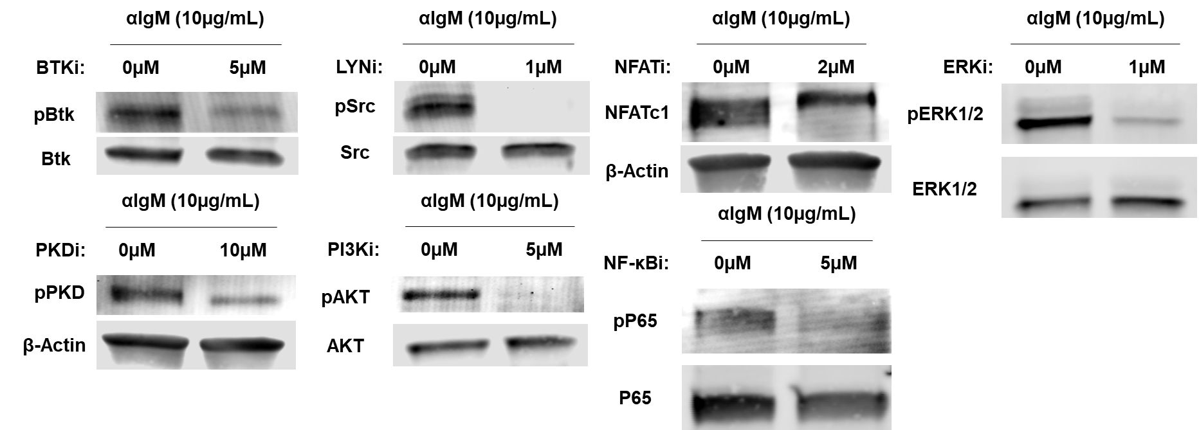
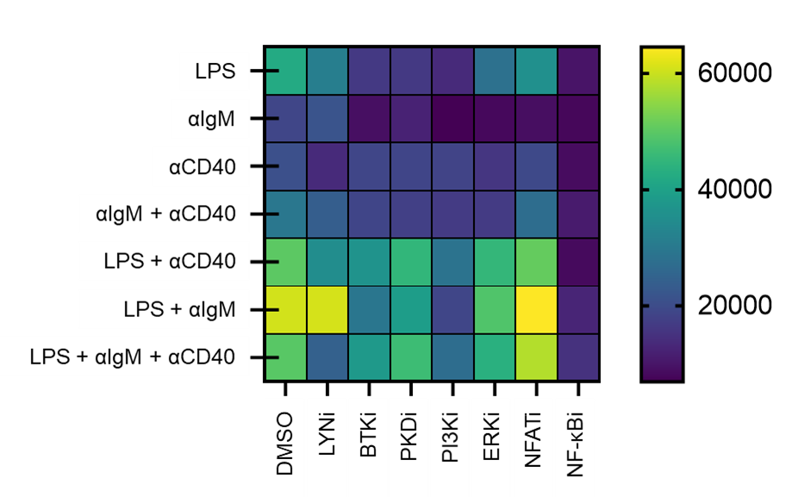
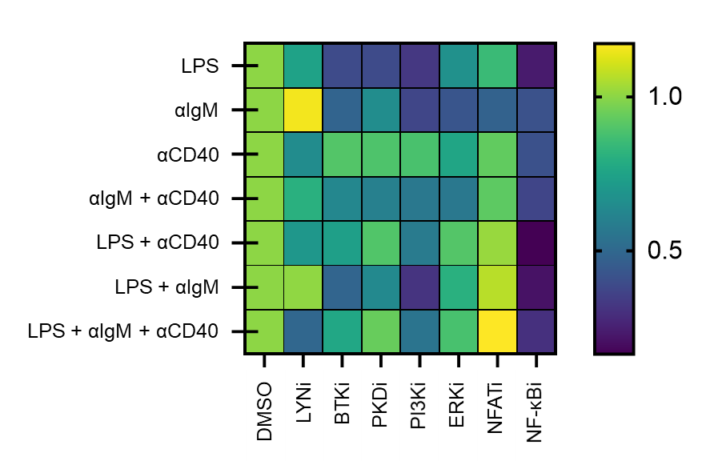
A)
B)
C)
Supplementary Figure 4. Data related to inhibition screen in Figure 4. A) Western blots of WT splenic B cells incubated with indicated inhibitor for 30 minutes prior to stimulation with αIgM (10µg/mL). 40ug of total protein loaded per lane. (B) Live CD19+ cell numbers associated with Figures 4A-D. N=3. (C) Fold change in B cell numbers from (B) compared to DMSO for each stimulation condition. N-=3.

Slide 5
A)
E)
B)
F)
C)
G)
D)
Supplementary Figure 5. Extended IL-35 reporter screen data. A-G) Frequencies of GFP⁺TdTomato⁺ B cells 48 hours after stimulation with DMSO or indicated inhibitor.

Slide 6
A)
E)
B)
F)
C)
G)
D)
Supplementary Figure 6. Mean fluorescent intensity (MFI) of TdTomato in reporter screen. A-G) Mean fluorescent intensity of TdTomato in B cells 48 hours after stimulation with DMSO or indicated inhibitor.

Slide 7
A)
E)
B)
F)
C)
G)
D)
Supplementary Figure 7. Mean fluorescent intensity (MFI) of GFP in reporter screen. A-G) Mean fluorescent intensity of GFP in B cells 48 hours after stimulation with DMSO or indicated inhibitor.

Slide 8
A)
B)
Spleen
Tumor
Supplementary Figure 8. Prkd2-S707A/S711A tumor study data. (A) Measured volumes and weights of orthotopic KPC4662 tumors from WT and Prkd2-S707A/S711A mice 21 days post-tumor injection. N=5-6. (B) Frequency of immune subsets found in the spleens (left) tumors (right) of WT and Prkd2-S707A/S711A orthotopic tumor-bearing mice. N=5-6.

Slide 9
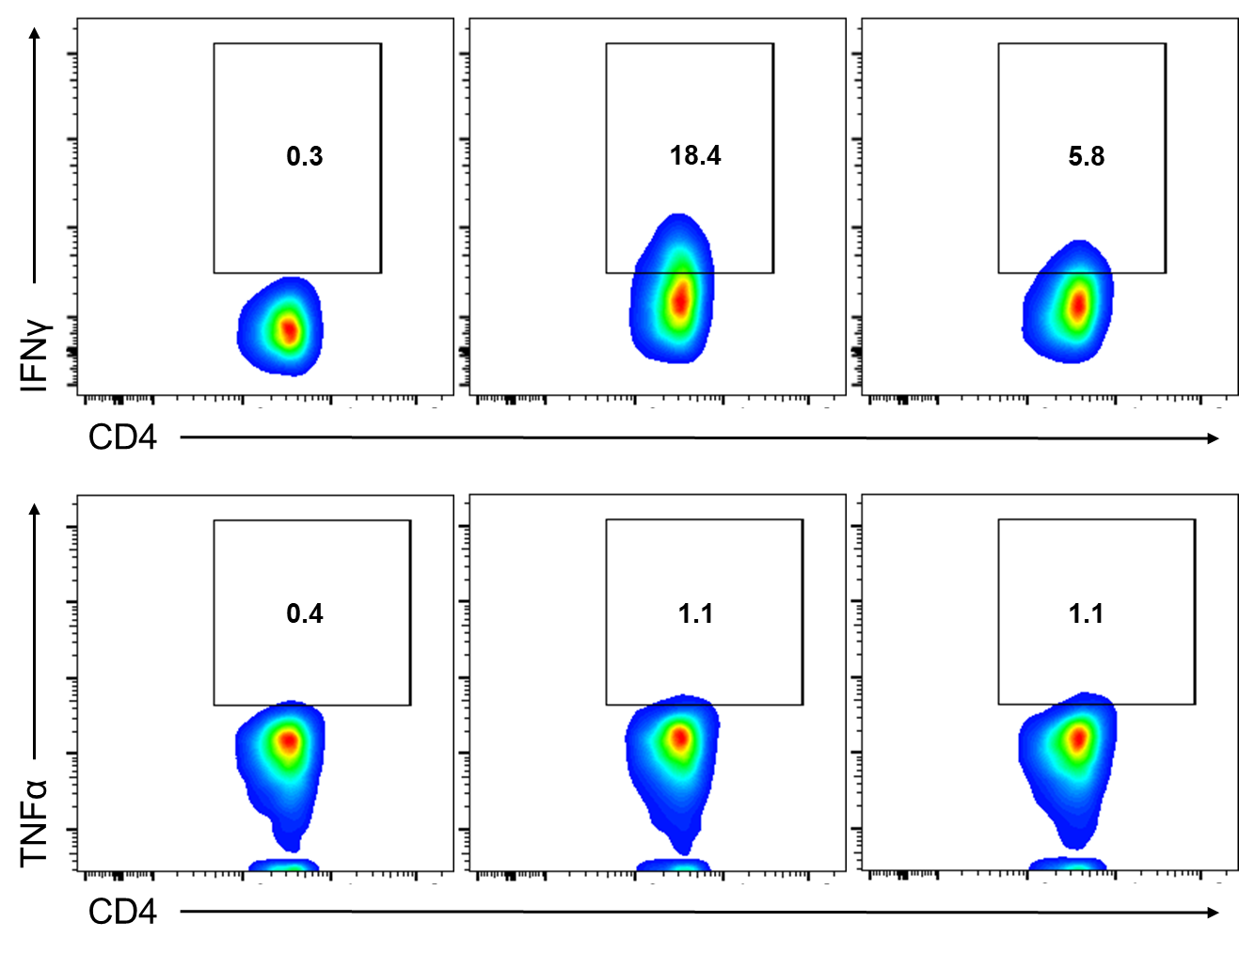
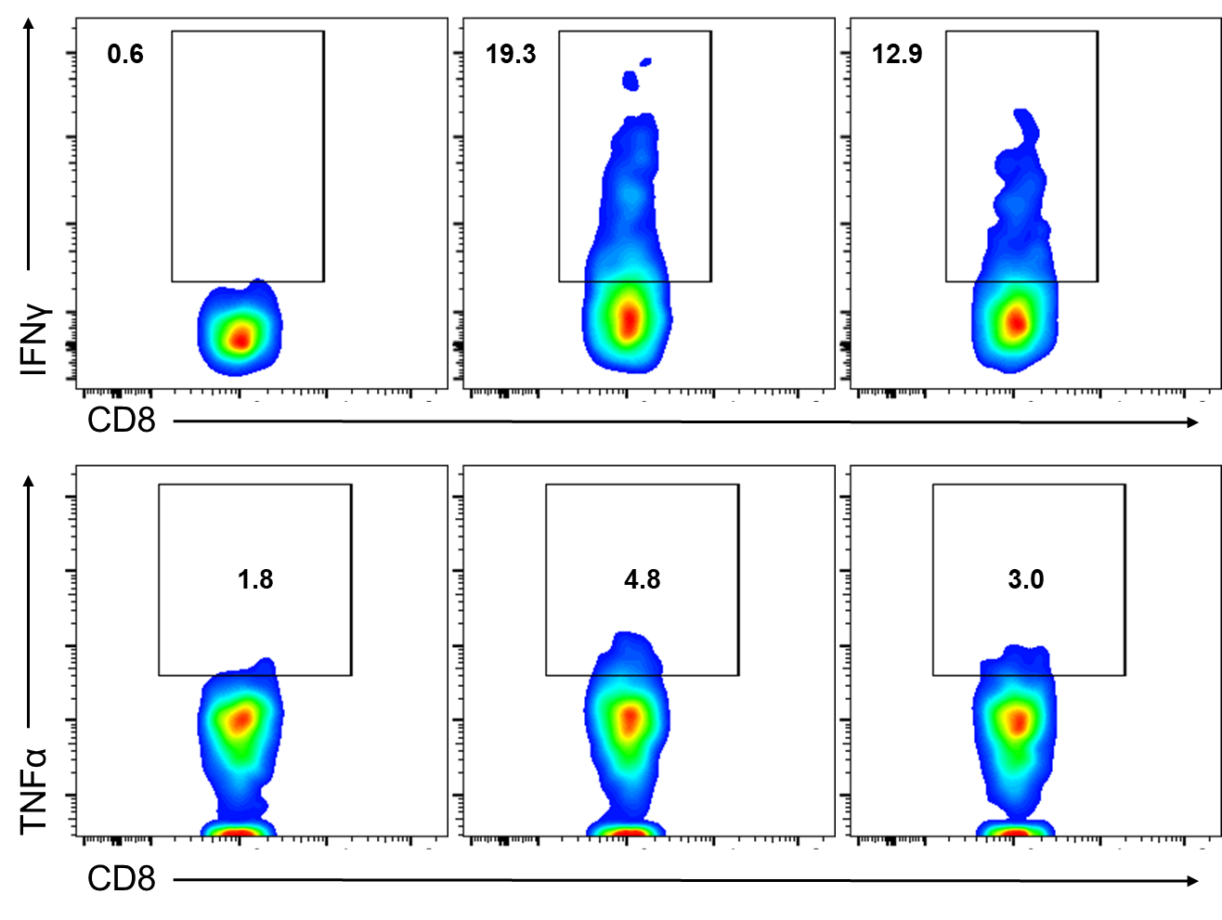
A)
B)
Supplementary Figure 9. PKD2 function is required for full IFNy and TNFα expression by activated T cells. A) Frequencies of IFNy⁺ and TNFα⁺ WT and Prkd2-S707A/S711A CD4⁺ T cellsafter αCD3/αCD28 stimulation. N=5. B) Frequencies of IFNy⁺ and TNFα⁺ WT and Prkd2-S707A/S711A CD4⁺ T cellsafter αCD3/αCD28 stimulation. N=5.

Slide 10
A)
Spleen
Tumor
Supplementary Figure 10. Extended CRT0066101 tumor study data. A) Frequencies of indicated CD19⁺ subsets isolated from spleens (left) and tumors (right) from vehicle and CRT0066101 treated mice.

Slide 11
A)
Il27a
Il12b
B)
Il10
Tgfb1
Pdcd1
Pdcd1l1
Supplementary Figure 11. Effect of PKD2 function on other IL-12 family cytokines and immunosuppressive effector proteins. A) Relative expression of Il27a and Il12b in CD1d^{Hi}CD21^{Hi}CD5⁺ WT and Prkd2-S707A/S711A B cells stimulated for 48 hours with indicated stimuli. N=3. B) Relative expression of Il10, Tgfb1, Pdcd1, and Pdcd1l1 in CD1d^{Hi}CD21^{Hi}CD5⁺ WT and Prkd2-S707A/S711A B cells stimulated for 48 hours with indicated stimuli. N=3.

