Slide 1
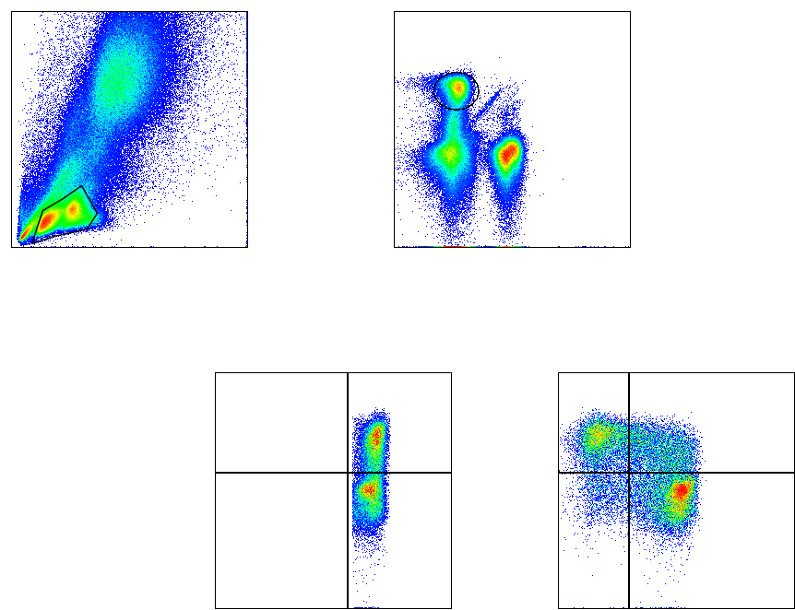
(A)
(B)
18.3%
SSC
CD8
42.1%
FSC
CD4
(C)
(D)
47.2%
25.9%
21.3%
CCR5
CCR5
CD8
CD45RA
Supplementary Figure 1: Gating strategy for lymphocytes, CD8⁺ T cells, CCR5, and CD45RA populations.
Whole blood gating strategy for lymphocytes, CD8⁺ T cells, and therein the CCR5 and CD45RA populations. The example shown uses 100 µL whole blood from a Ghanaian study participant. Panel A: lymphocytes were gated used the forward scatter-height versus side scatter-height. Panel B: lymphocytes were separated into CD8⁺ T cells by gating CD8 expression. Panel C: CCR5 was plotted with CD8 to obtain CD8⁺CCR5⁺ T cells. Panel D: CCR5 and CD45RA were plotted together to obtain CD8⁺CCR5⁺CD45RA⁻ T cells and CD8⁺CCR5⁺CD45RA⁺ T cells. The red marked gates show the positive populations.

Slide 2
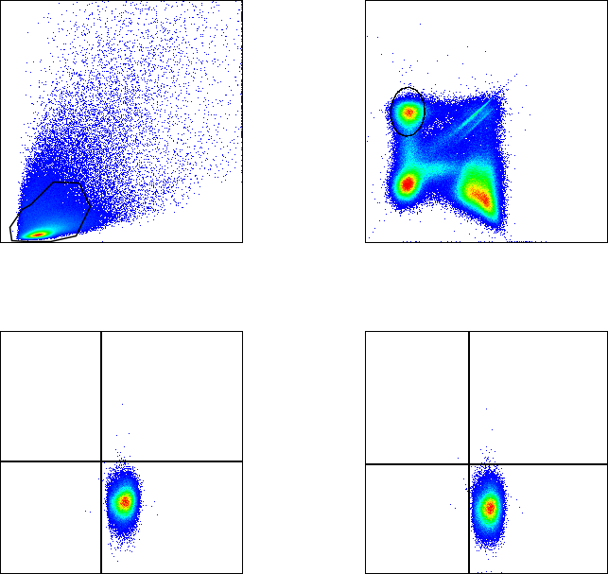
(A)
(B)
15.1%
SSC
CD8
95.8%
FSC
CD4
(C)
(D)
0.028%
0.041%
IFN-γ
IL-10
CD8
CD8
Supplementary Figure 2: Gating strategy for CD8⁺ IFN-γ⁺ and IL-10⁺ populations.
PMBC gating strategy for lymphocytes, CD8⁺ T cells, and therein the IFN-γ⁺ and IL-10⁺ populations. The representative example shown is from PBMCs isolated from a Ghanaian study participant. Panel A: lymphocytes were first gated using forward scatter-height versus side scatter-height. Panel B: lymphocytes were separated into CD8⁺ T cells by gating CD8 expression. Panels C and D: IFN-γ⁺ cells (C) could then be further examined along with IL-10⁺ cells (D). The red marked gates show the positive populations.

Slide 3
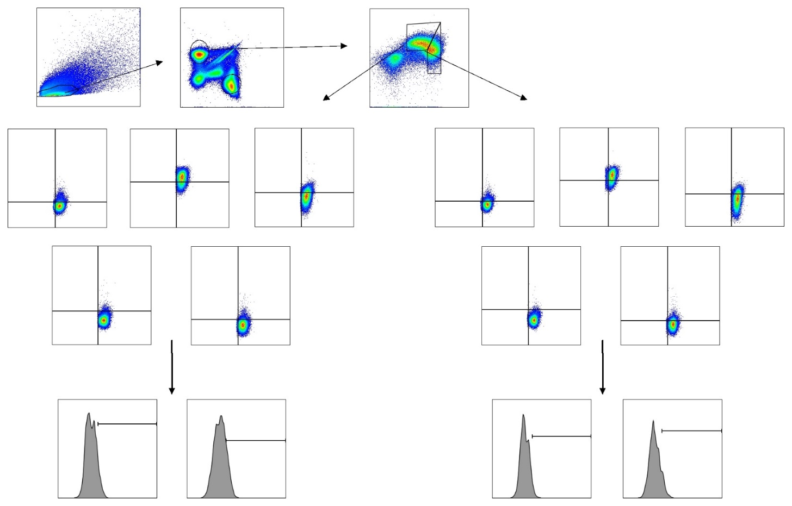
(A)
(B)
(C)
Lymphocytes
88.8
CD8
30.0
CD8⁺Ex_{mem} 38.9
SSC
CD8
Eomes
CD4
29.8
CD8⁺Ex_{eff} 30.6
(D)
FSC
CD4
T-bet
0.32
9.21
0.81
73.3
0.27
24.0
(E)
0.21
11.6
3.67
76.4
0.05
17.8
CD39
KLRG-1
PD-1
CD39
KLRG-1
PD-1
4.48
86.0
4.48
25.1
1.89
73.8
1.99
86.2
2.12
17.8
0.56
81.5
CD8
CD8
CD8
CD8
CD8
CD8
0.00
2.06
0.11
5.77
0.00
0.66
0.17
13.2
LAG-3
Tim-3
LAG-3
Tim-3
0.38
97.6
2.87
91.2
1.28
98.1
1.37
85.3
CD8
CD8
CD8
CD8
(F)
(G)
(H)
(I)
IFN-γ⁺
IL-10⁺
IFN-γ⁺
IL-10⁺
10.5
16.3
4.81
11.6
IFN-γ
IL-10
IFN-γ
IL-10
Supplementary Figure 3: Gating strategy for exhaustion markers and cytokines on CD8⁺ex_{mem} and CD8⁺ex_{eff} populations.
PBMC gating strategy for lymphocytes, CD8⁺ T cells, and therein the CD8⁺ex_{mem}, and CD8⁺ex_{eff} populations. The example shown uses PBMCs from a Ghanaian study participant. Panel A: lymphocytes were gated using the forward scatter-height versus side scatter-height. Panel B: lymphocytes were separated into CD8⁺ T cells by gating CD8 expression. Panel C: Eomes and T-bet expression were plotted together to obtain CD8⁺ex_{mem} and CD8⁺ex_{eff} cell populations for further analysis (as previously described, Buggert 2014). Panel D and E: CD8⁺ex_{mem} and CD8⁺ex_{eff} cell subpopulations were further investigated for their ability to express certain cell surface markers associated with exhaustion (CD39, KLRG1, PD-1, LAG-3 and Tim-3). The red marked gates show the positive populations. Panel F and H: IFN-g expression in CD8⁺ex_{mem} and CD8⁺ex_{eff} T cells which expressed the described exhaustion markers were evaluated to determine the T cells’ functionality. Panel G and I: IL-10 expression in CD8⁺ex_{mem} and CD8⁺ex_{eff} T cells which expressed the described exhaustion markers were evaluated to determine the T cells’ functionality.

