Slide 1
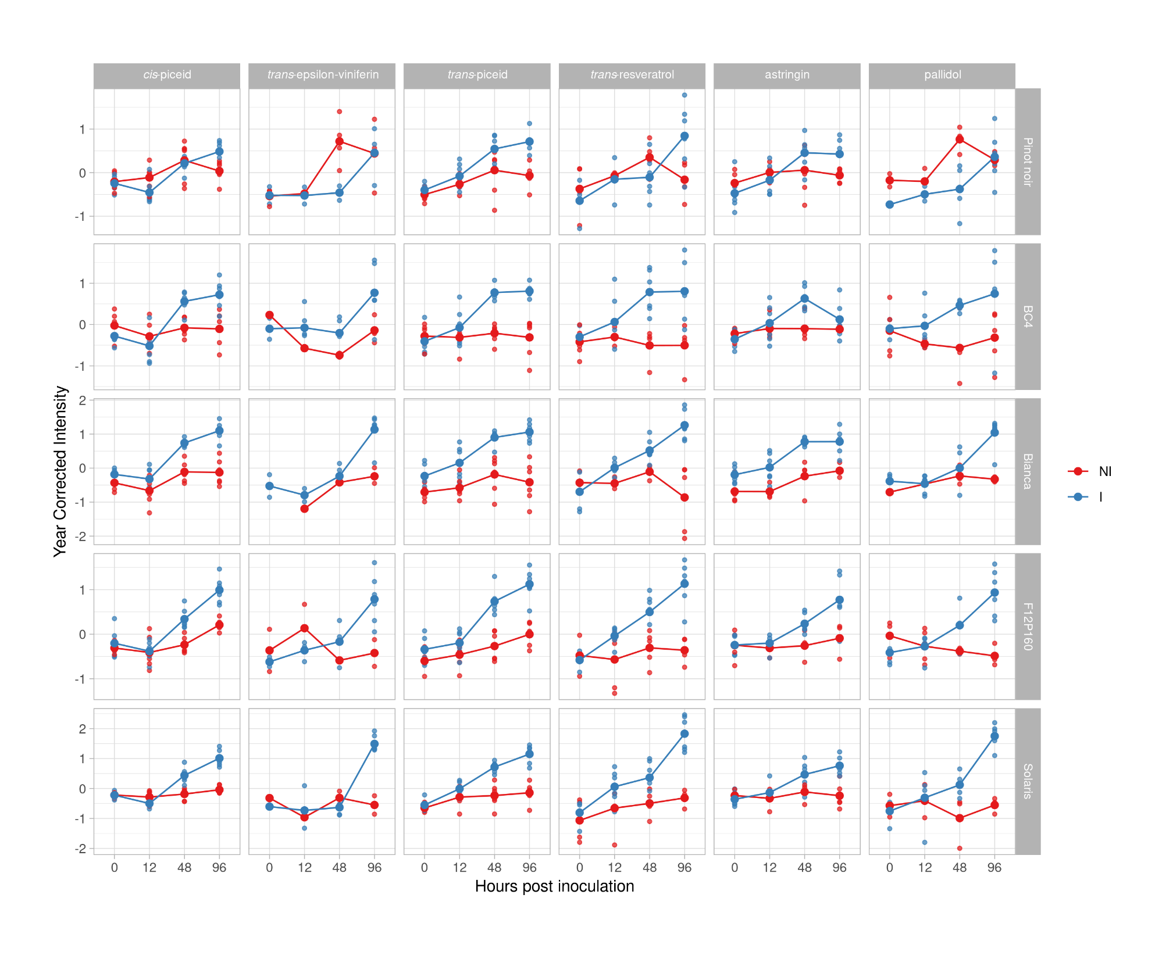
Supplementary Figure 1: Stilbenes and Stilbenoids meeting the described criteria in mono-locus genotypes; inoculated (Red) and not inoculated (Blue).

Slide 2
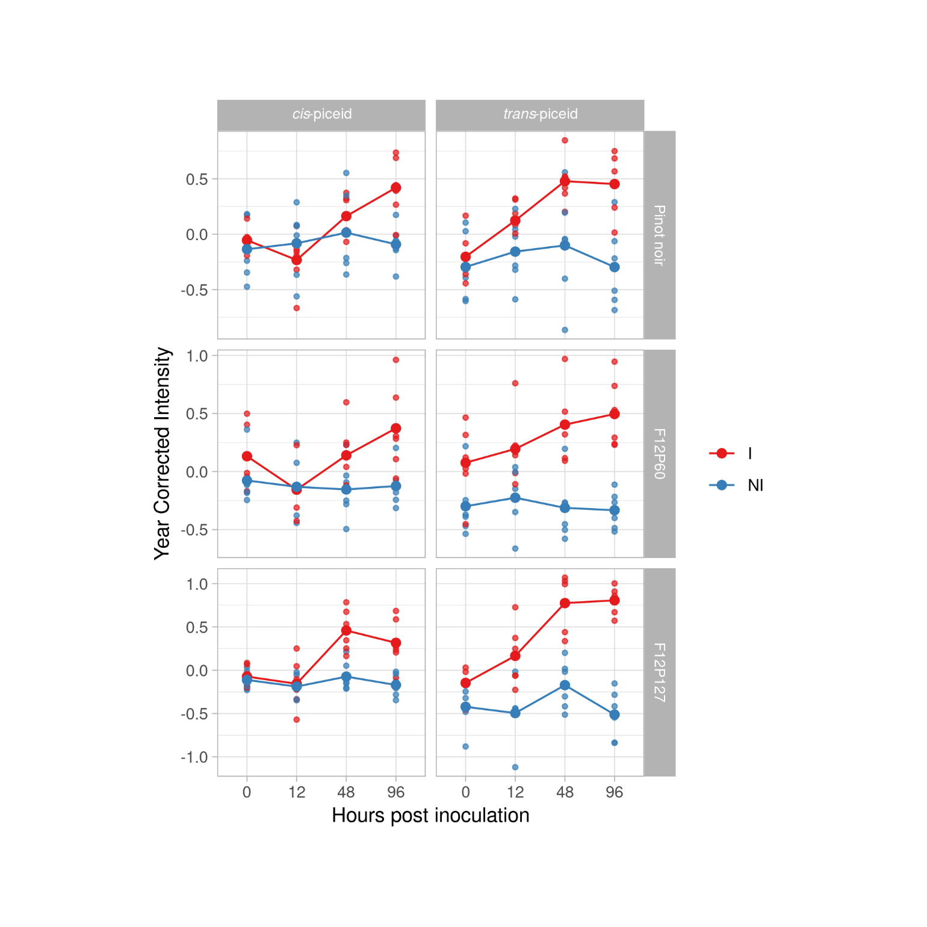
Supplementary Figure 2: Stilbenes and Stilbenoids meeting the described criteria in pyramided genotypes; inoculated (Red) and not inoculated (Blue).

