Slide 1
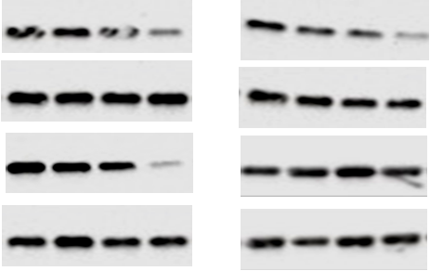
A
B
PBI-05204 (μg/ml)
0 0.5 1.0 5.0
PBI-05204 (μg/ml)
0 0.5 1.0 5.0
NF-κB p65
Tubulin
Gadd45β
Tubulin
Figure S1. Western blot analysis of NF-κB p65 and Gadd45β in PBI-05204 treated U87MG (A) and U251 (B) cells.

Slide 2
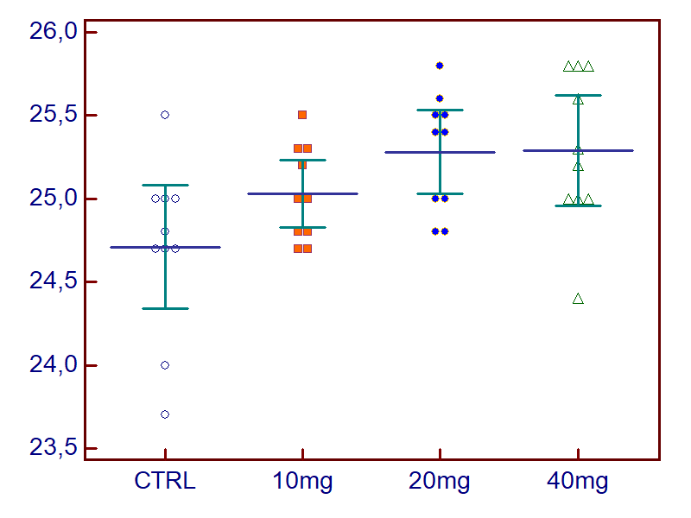
Body weight (g)
Figure S2. Terminal body weight of mice bearing U87MG xenograft treated with PBI-05204.

Slide 3
Table S1. Immunohistochemical evaluation on markers of proliferation, apoptosis, and angiogenesis in vehicle treated (control)
and PBI-05204 treated U251 xenografts
 | U251
Markers | Vehicle CTRL | PBI-05204 (10 mg/Kg) | PBI-05204 (20 mg/Kg) | PBI-05204 (40 mg/Kg)
Vessel count Percentage of CD31+ vessels | 18.4 ± 4.2 | 13.7 ± 3.5 | 10.8 ± 2.4* | 9.0 ± 1.0*
Percentage of Ki67+ cells | 40.7± 8.8 | 36.4 ± 2.0 | 25.2 ± 2.4* | 13.5 ± 2.8*
Apoptosis. percentage of tunnel positive cells (%) | <2% | 7.5 ± 2.5* | 13.0 ± 3.0* | 18.7 ± 7.0
Necrosis Percentage(%) | <2% | 5.7 ± 2.5* | 7.9 ± 2.5* | 16.9 ± 6.5*
* P < 0.05

Slide 4
Table S2. Immunohistochemical evaluation on markers of proliferation, apoptosis, and angiogenesis, in vehicle (control) and PBI-05204 treated T98G xenografts
 | T98G
Marker | Vehicle CTRL | PBI-05204 (10 mg/Kg) | PBI-05204 (20 mg/Kg) | PBI-05204 (40 mg/Kg)
Vessel count Percentage of CD31+ vessels | 20.8 ± 5.0 | 13.5 ± 3.5 | 10.0 ± 2.0* | 8.0 ± 2.5*
Percentage of Ki67+ cells | 35.5 ± 9.0 | 27.7 ± 3.0 | 15.0 ± 2.5* | 12.0 ± 2.8*
Apoptosis. percentage of tunnel positive cells | <2% | 7.0 ± 2.0* | 13.5 ± 4.0* | 15.5 ± 5.5*
Necrosis percentage | 5.0 ± 1.0 | 10.0 ± 1.5 | 12.8 ± 3.5 | 22.5 ± 4.0*
* P < 0.05

