Slide 1
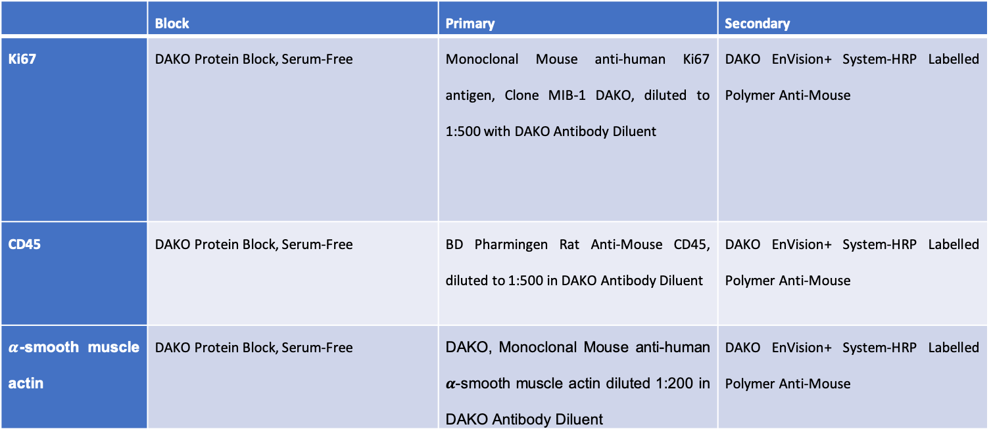
Supplementary Table 1. Immunohistochemical protocol details
 | Block | Primary | Secondary
Ki67 | DAKO Protein Block, Serum-Free | Monoclonal Mouse anti-human Ki67 antigen, Clone MIB-1 DAKO, diluted to 1:500 with DAKO Antibody Diluent | DAKO EnVision+ System-HRP Labelled Polymer Anti-Mouse
CD45 | DAKO Protein Block, Serum-Free | BD Pharmingen Rat Anti-Mouse CD45, diluted to 1:500 in DAKO Antibody Diluent | DAKO EnVision+ System-HRP Labelled Polymer Anti-Mouse
$α$-smooth muscle actin | DAKO Protein Block, Serum-Free | DAKO, Monoclonal Mouse anti-human $α$-smooth muscle actin diluted 1:200 in DAKO Antibody Diluent | DAKO EnVision+ System-HRP Labelled Polymer Anti-Mouse

