Slide 1
Project Westdrive: Foundation for future virtual reality studies.
Supplementary Materials

Slide 2
2,3 Km² Base Area
220 Cars
259 Buildings
518 traffic signs
655 pedestrians
9944 street probs
~16000 nature assets
Overview
Notes:
- Westdrive Überblick, Route, Passanten, Zahlen zu Objekten, Passanten
>> System ... -> Beeindruckende und flexible VR Umgebung. Geeignet für
>> viele Untersuchungen

Slide 3
Westdrive from above

Slide 4
Westdrive - Example Use case
...
Transparent AI
under which conditions do humans build trust in a machine agent?
Does trust building differ in a self-driving car compared to a conventional Taxi?
Are potentially dangerous traffic situations perceived and assessed differently when the AI provides information on their condition?
!
...

Slide 5
Key features
City Ai
20 paths for cars
120 cars simulated
100 different avatars
30 paths for pedestrians
600 simulated pedestrians

Slide 6
Westdrive - traffic Lights

Slide 7
Westdrive, a realistic environment

Slide 8
Westdrive, a realistic environment

Slide 9
Westdrive, a realistic environment

Slide 10
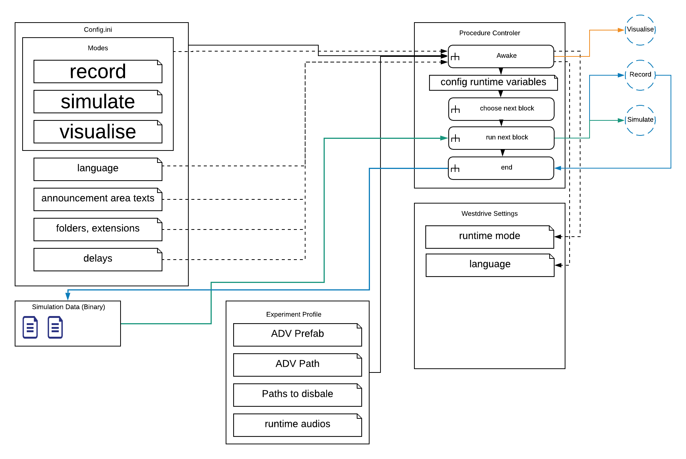
Westdrive 2.0 - Current Architecture
General overview

Slide 11
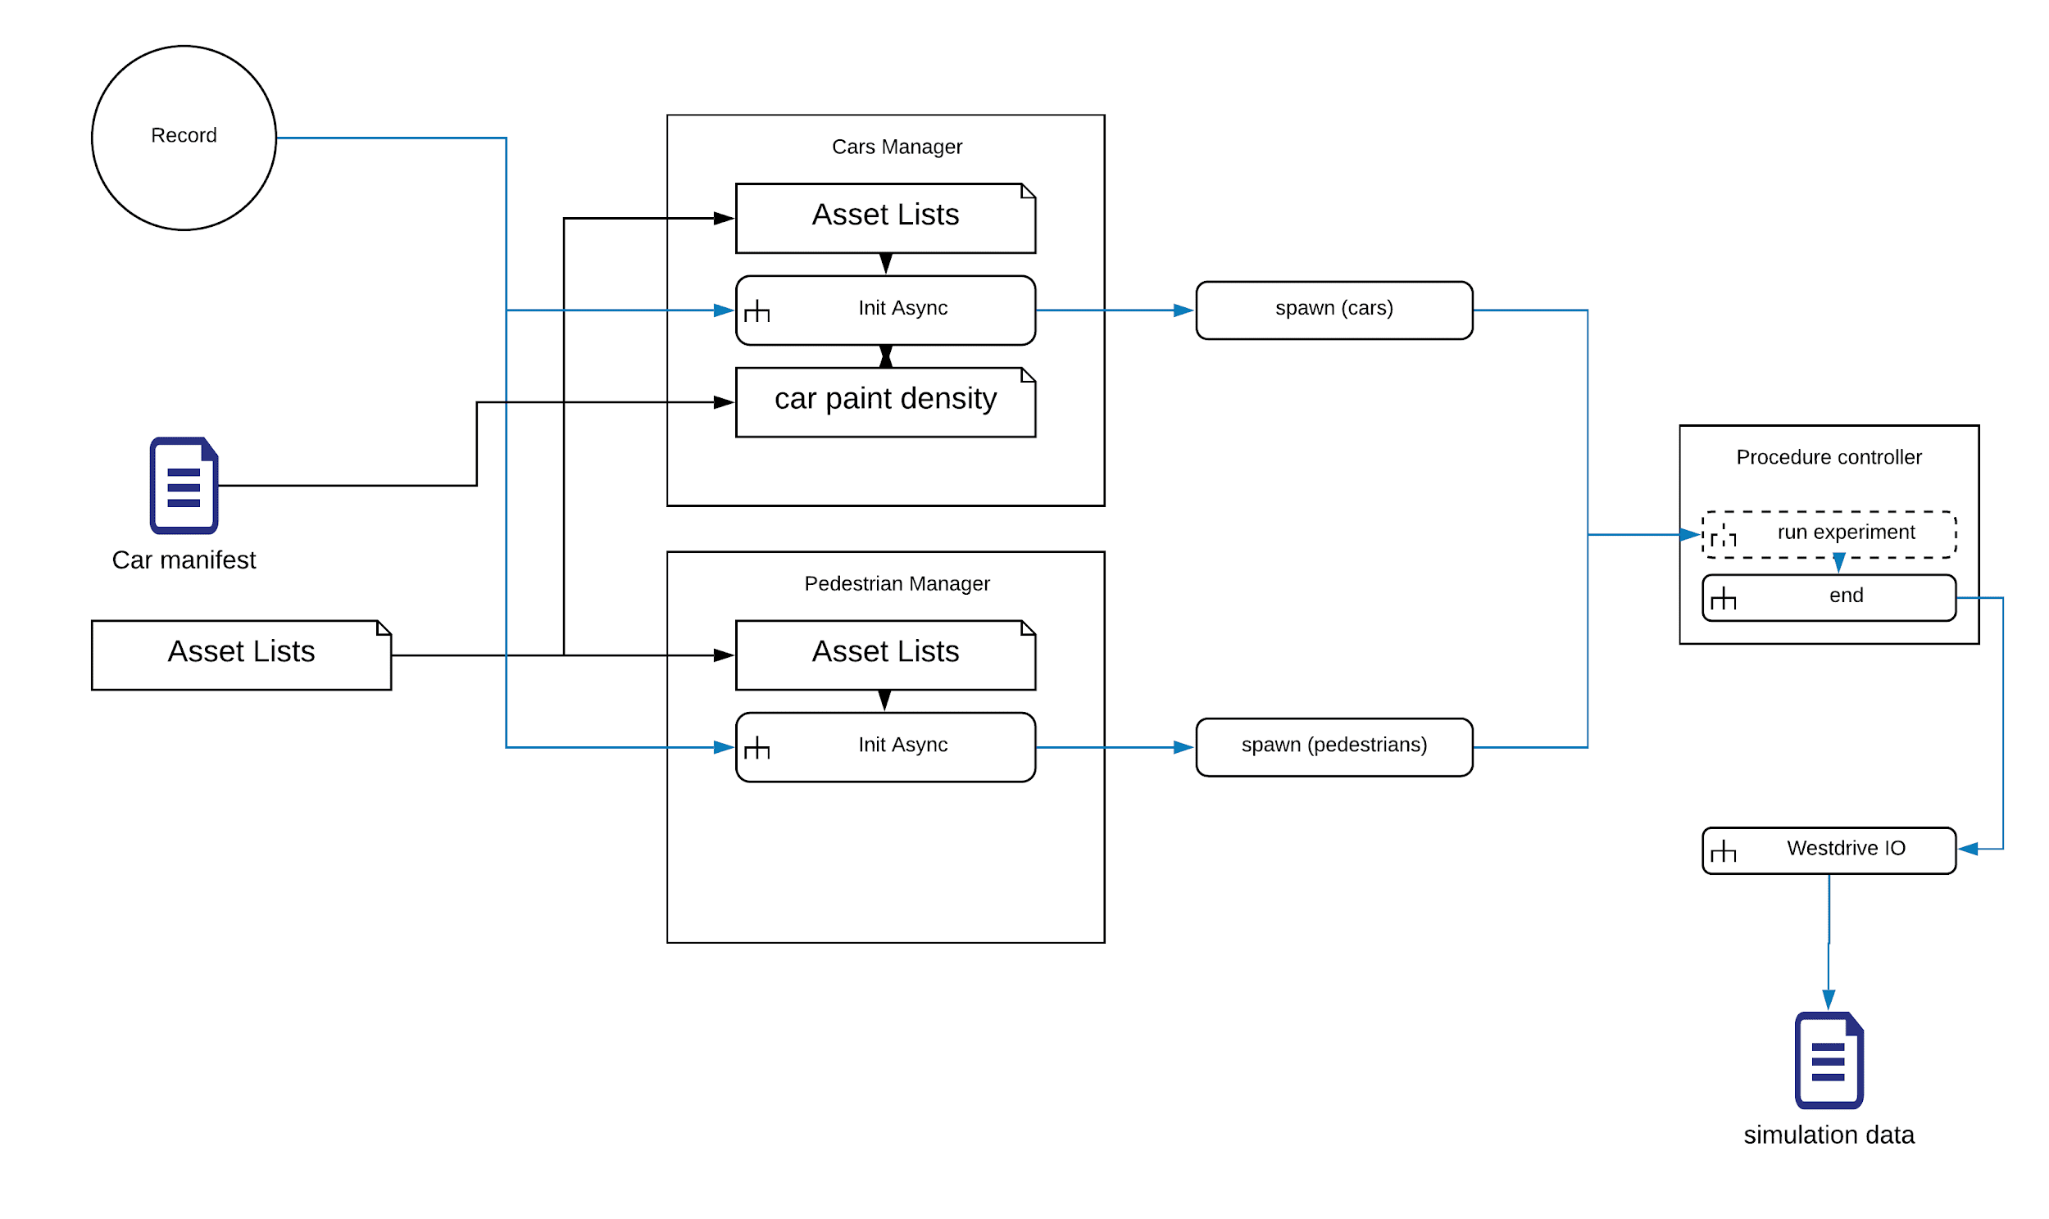
Westdrive 2.0 - Current Architecture
Record Mode

Slide 12
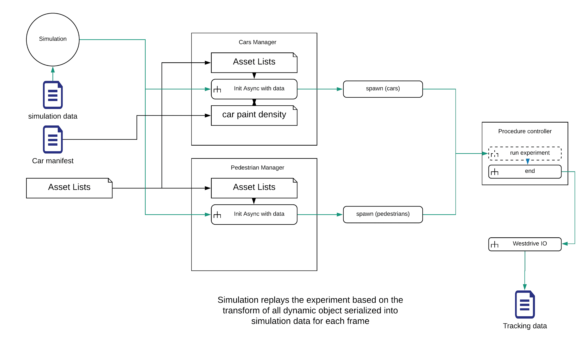
Westdrive 2.0 - Current Architecture
Simulation mode

Slide 13
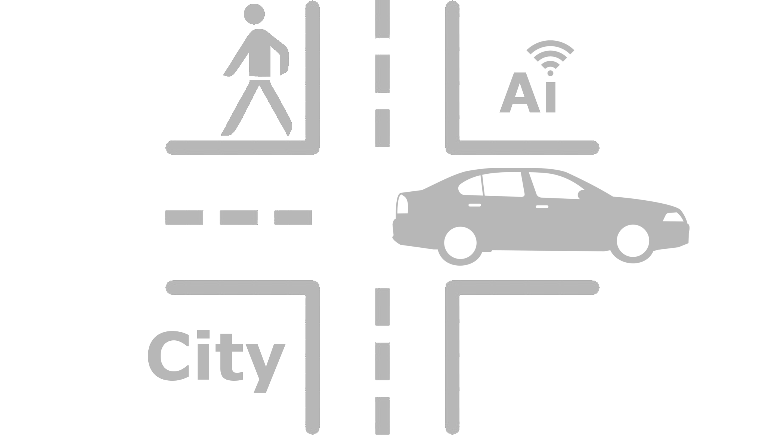
Westdrive 2.0 - City AI
Standalone toolkit
Easy to use
No coding needed
Available on Gitlab

Slide 14
City AI Toolkit
Minimalistic car engine
Kinematics based simulation
Avoidance
barebone AI functionalities
Traffic lights
Automatic spawn and management
Homogenous speed
Light weight code
Deterministic

Slide 15
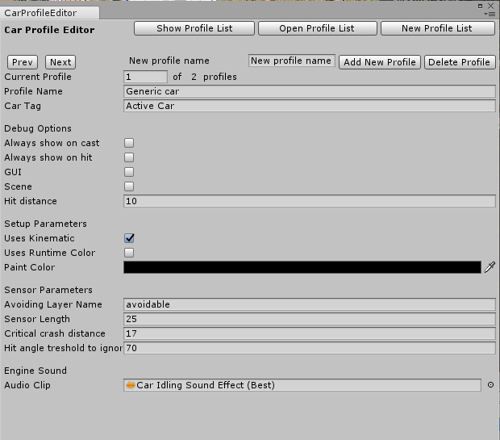
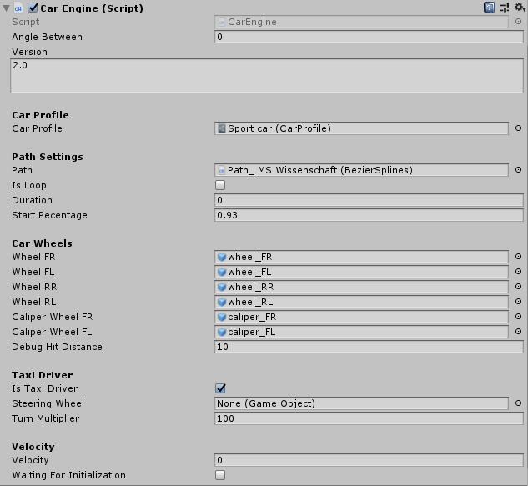
City AI Toolkit
Minimalistic car engine
Car Profile creation and management
Car Engine GUI and parameters

Slide 16
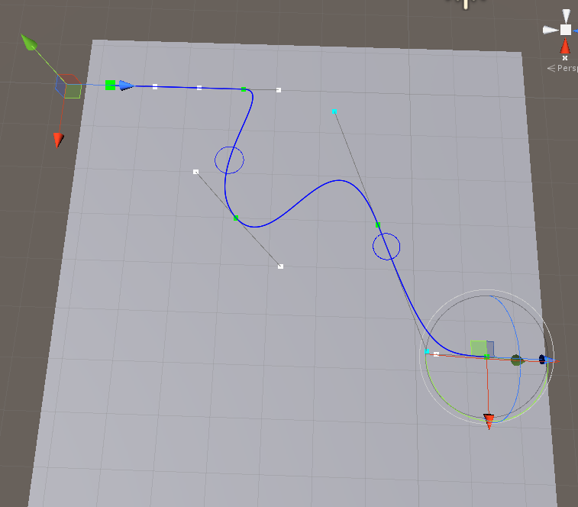
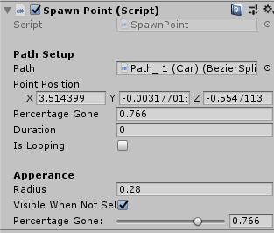
City AI
Path toolkit and managers

Slide 17
Westdrive planned developements
Transition to Entity Component System for performance improvements
Further Optimizations for better frame rate
Including generic eye tracking toolkit
Testing Westdrive in context of spatial navigation studies

Slide 18
Westdrive - Development cycle
Performance boost and finalization
Improve Westdrive performance and finalize the version
Version freeze
Publish Stable Version of Westdrive on main branch
Westdrive
Development cycle
Second Debugging
Debug added new features and stabilize
First Debugging
Debug current version of Westdrive
Feature implementation and adaptation
Developing new features for Westdrive and City AI and adapt it for new unity versions

Slide 19
Westdrive - Tutorial Videos
To view tutorials click on the links below
City AI Part 1
City AI Part 2
Project Overview
Generic API
Demo Video

Slide 20
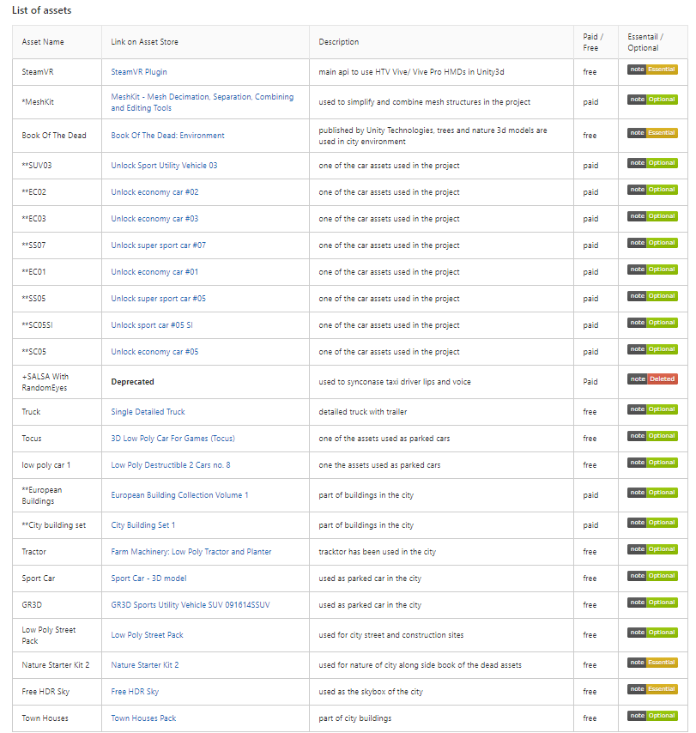
Westdrive - Asset List
* - This asset is used once and will be deleted once the city is updated with our assets but will be in use for the next year.
** - These assets are part of the city now but they will be replaced with the assets created at our team during the course of next year and will be deleted from our repository then.
+ - Already deleted from project
To access the link to the assets used on project Westdrive please check the readme file in our Gitlab repository.

Slide 21
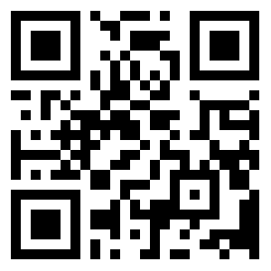
Get Westdrive on Gitlab

