Slide 1
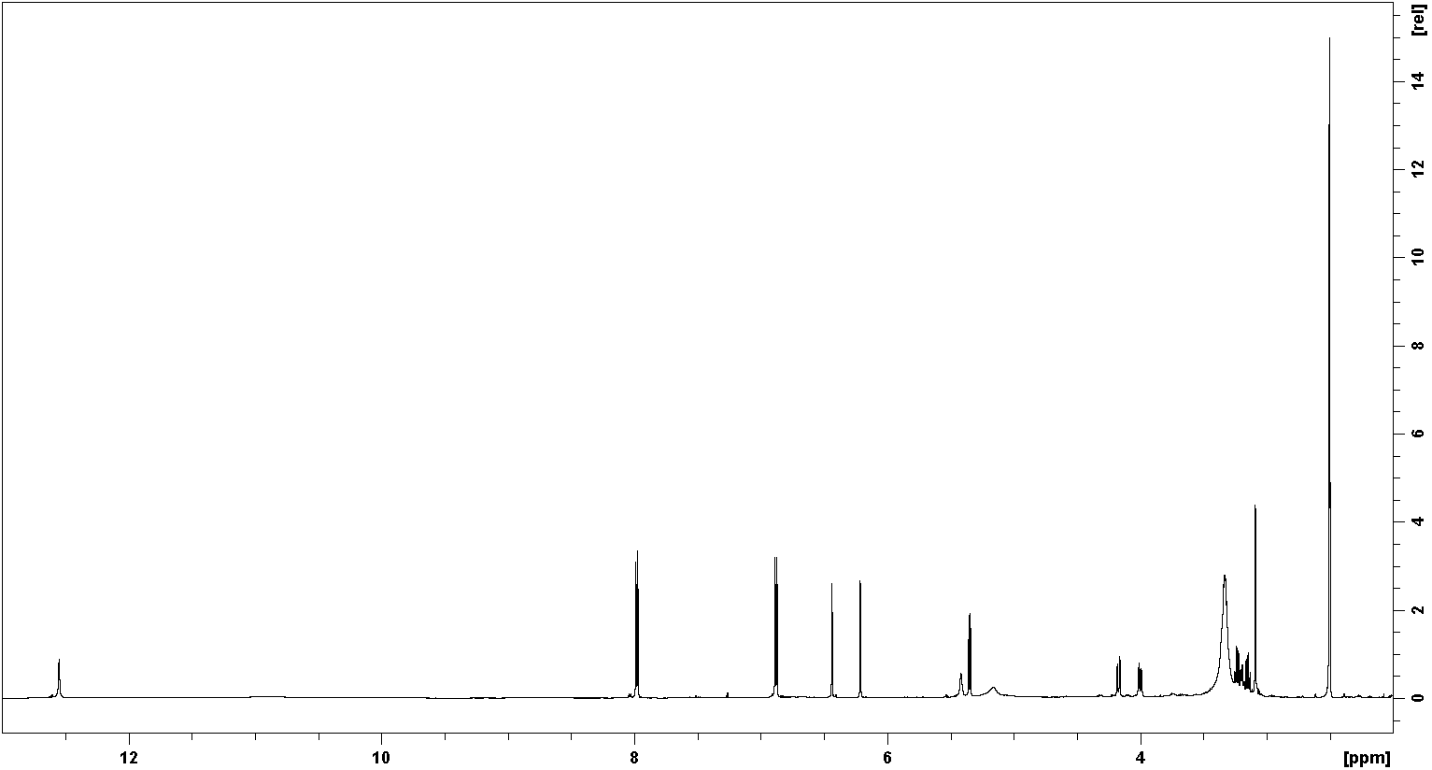
¹H Spectrum

Slide 2
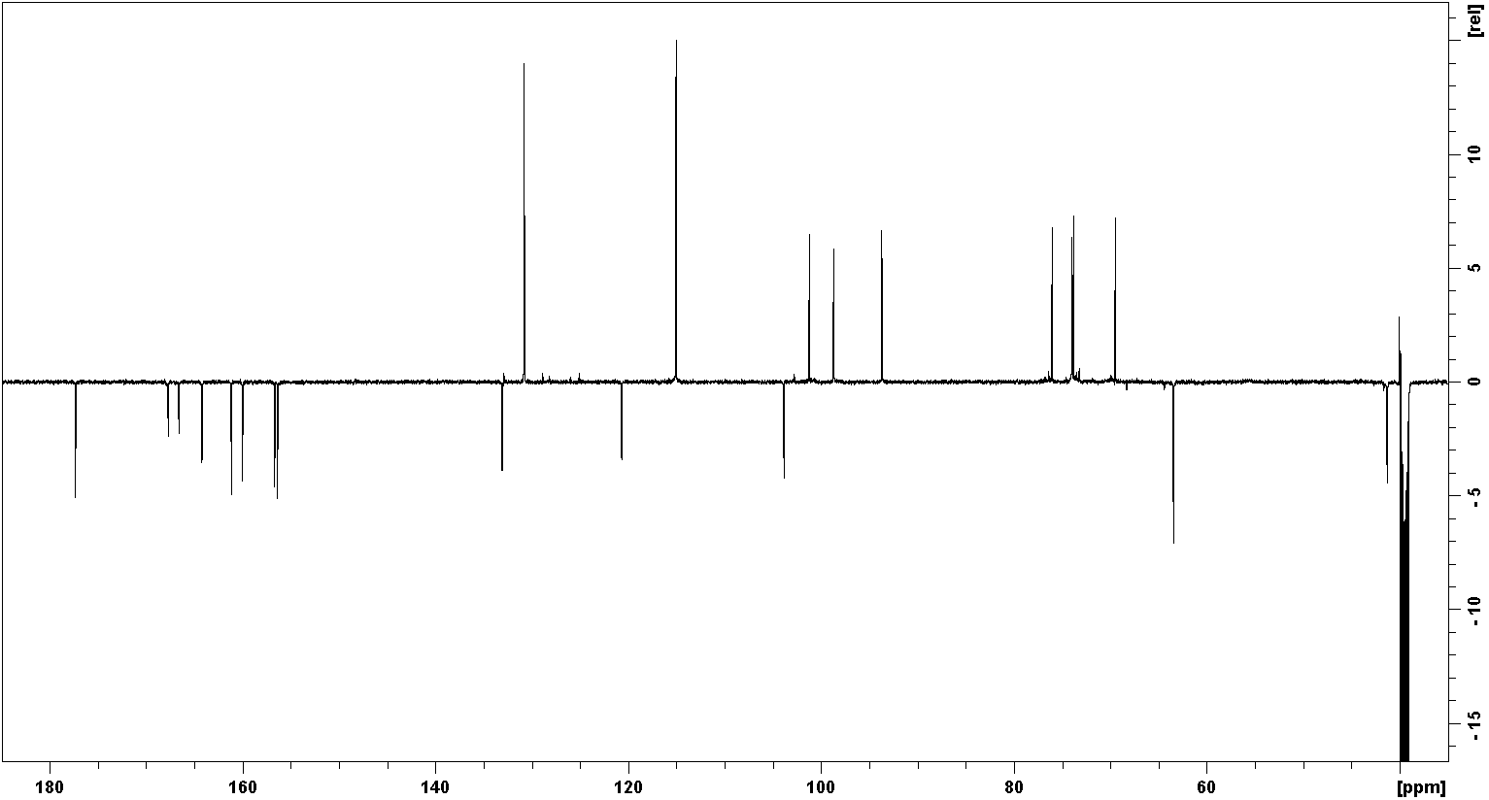
¹³C DEPTq135 Spectrum

Slide 3
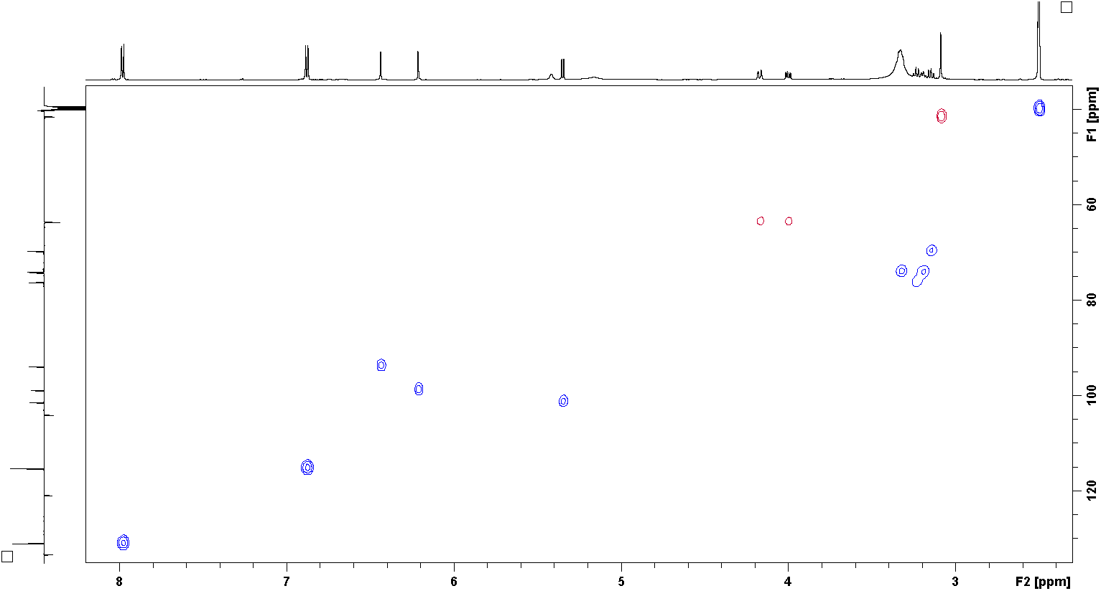
¹H¹³C gHSQC Spectrum

Slide 4
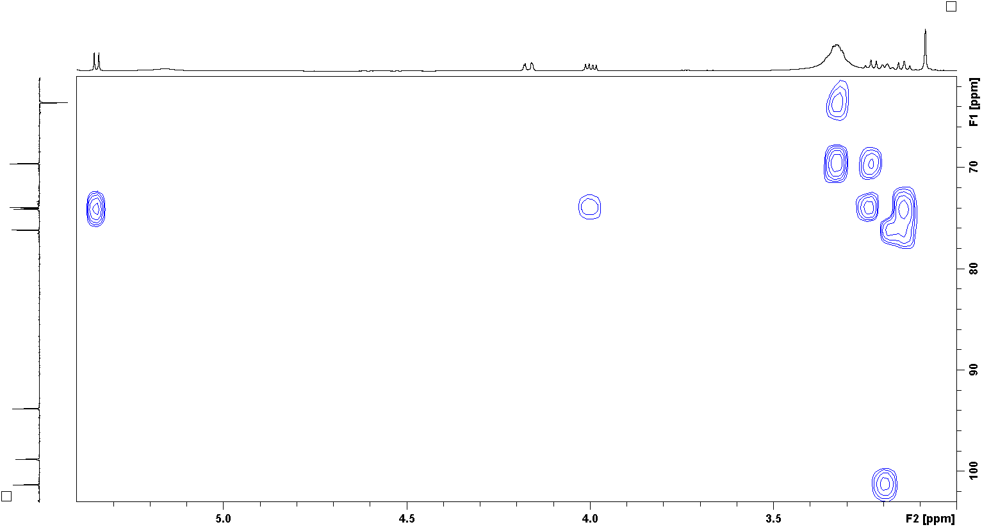
¹H¹³C gH2BC Spectrum

Slide 5
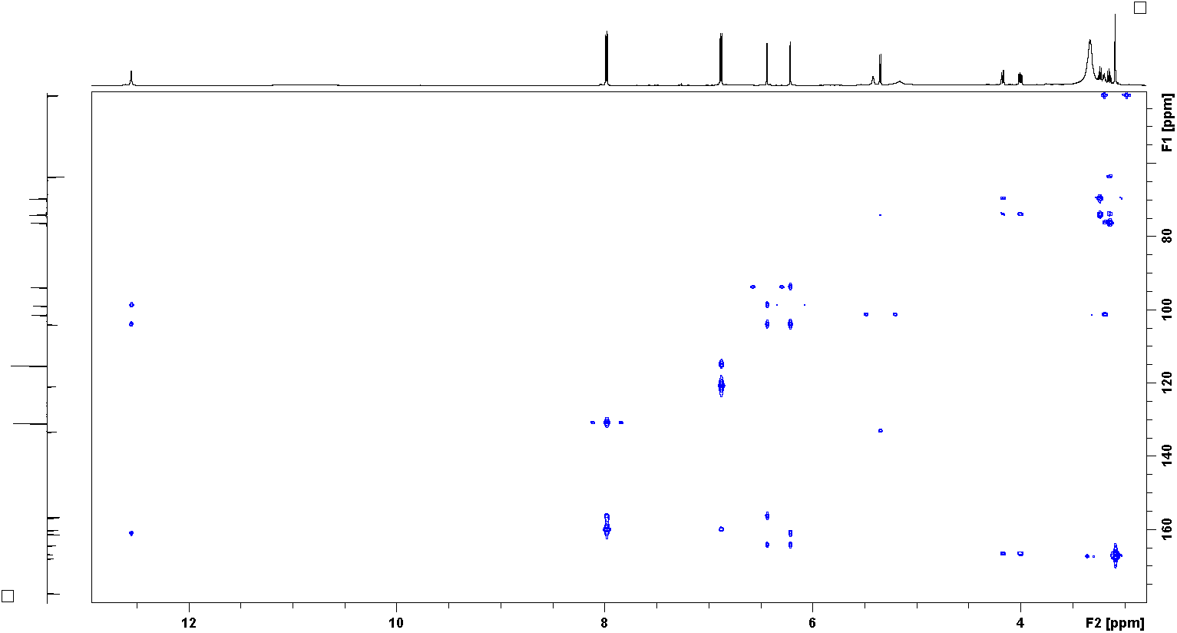
¹H¹³C gHMBC Spectrum

