Slide 1
Fig. S1 Taxonomic distribution of BLASTX top hit against NCBI NR in Chattonella antiqua.

Slide 2
Fig. S2 A result of the Benchmarking Universal Single-Copy Orthologs (BUSCO) analysis.

Slide 3
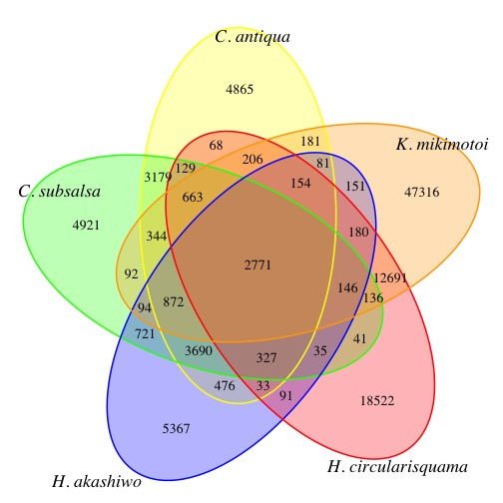
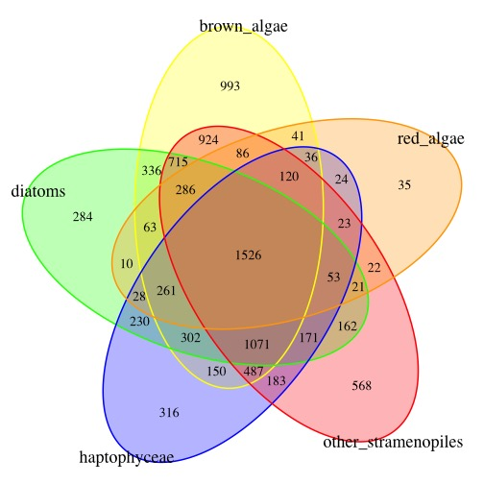
Fig. S3 Presence and absence patterns of orthologs among various algae.

Slide 4
Fig. S4 A result of comparative analysis among Chattonella antiqua and the other organisms using RECOG. Data with asterisks indicate assembled RNA sequence data were used for the analysis.
60806
31842

Slide 5
Fig. S5 A phylogenetic tree drawn using a concatenated alignment of universally conserved and nearly one-to-one orthologous groups.
Haptophyceae
Dinophyceae
Oomycetes
Phaeophyceae
Raphidophyceae
Bacillariophyta
Eustigmatophyceae
Rhodophyta
Viridiplantae

Slide 6
Fig. S6: Functional categories based on GO annotations (biological process) for all transcripts (a), highly expressed transcripts (b), expressed more highly during the daytime (c) or during the nighttime (d).
a)
b)
GO:0005975 carbohydrate metabolic process
GO:0006091 generation of precursor metabolites and energy
GO:0006259 DNA metabolic process
GO:0006412 translation
GO:0006457 protein folding
GO:0006461 protein complex assembly
GO:0006464 cellular protein modification process
GO:0006457 protein folding
GO:0006520 cellular amino acid metabolic process
GO:0006629 lipid metabolic process
GO:0006790 sulfur compound metabolic process
GO:0006810 transport
GO:0006950 response to stress
GO:0007049 cell cycle
GO:0007165 signal transduction
GO:0008150 biological_process
GO:0008219 cell death
GO:0009056 catabolic process
GO:0009058 biosynthetic process
GO:0015979 photosynthesis
GO:0016192 vesicle-mediated transport
GO:0019538 protein metabolic process
GO:0034641 cellular nitrogen compound metabolic process
GO:0042254 ribosome biogenesis
GO:0044281 small molecule metabolic process
GO:0051186 cofactor metabolic process
GO:0051276 chromosome organization
GO:0055085 transmembrane transport
c)
d)

Slide 7
Fig. S7 Functional categories based on GO annotations (cellular component) for all transcripts (a), highly expressed transcripts (b), expressed more highly during the daytime (c) or during the nighttime (d).
(a)
(b)
GO:0005575 cellular_component
GO:0005576 cytoskeleton
GO:0005622 intracellular
GO:0005623 cell
GO:0005634 nucleus
GO:0005654 nucleoplasm
GO:0005694 chromosome
GO:0005730 nucleolus
GO:0005737 cytoplasm
GO:0005739 mitochondrion
GO:0005783 endoplasmic reticulum
GO:0005829 cytosol
GO:0005840 ribosome
GO:0005856 cytoskeleton
GO:0005886 plasma membrane
GO:0005929 cilium
GO:0009536 plastid
GO:0009579 thylakoid
GO:0043226 organelle
GO:0043234 protein complex
(c)
(d)

Slide 8
Fig. S8 Functional categories based on GO annotations (molecular function) for all transcripts (a), highly expressed transcripts (b), expressed more highly during the daytime (c) or during the nighttime (d).
(a)
(b)
GO:0003674 molecular_function
GO:0003677 DNA binding
GO:0003723 RNA binding
GO:0003735 structural constituent of ribosome
GO:0003924 GTPase activity
GO:0004518 nuclease activity
GO:0008135 translation factor activity, RNA binding
GO:0008168 methyltransferase activity
GO:0008233 peptidase activity
GO:0016301 kinase activity
GO:0016491 oxidoreductase activity
GO:0016746 transferase activity, transferring acyl groups
GO:0016765 transferase activity, transferring alkyl or aryl
(other than methyl) groups
GO:0016791 phosphatase activity
GO:0016779 nucleotidyltransferase activity
GO:0016798 hydrolase activity, acting on glycosyl bonds
GO:0016829 lyase activity
GO:0016853 isomerase activity
GO:0016874 ligase activity
GO:0016887 ATPase activity
GO:0019843 rRNA binding
GO:0022857 transmembrane
GO:0043167 ion binding
(c)
(d)

Slide 9
Fig. S9 A biosynthesis pathway of chlorophyll in Chattonella antiqua (Ca), Chattonella subsalsa (Cs), Heterosigma akashiwo (Ha), Karenia mikimotoi (Km), and Heterocapsa circularisquama (Hc). Red and gray boxes mean that the orthologous gene of the protein were found and were not in each RNA-seq data, respectively.
Glutamate
6.1.1.17 GTS
4.2.1.75 UROS
2.1.1.11 PPMT
Ca
Cs
Ha
Ca
Cs
Ha
Ca
Cs
Ha
Km
Hc
Km
Hc
Km
Hc
Glutamyl-tRNA
Uroporphyrinogen III
Mg-protoporphyrin IX monomethyl ester
1.2.1.70 GTR
4.1.1.37 UROD
1.14.13.81
(chloroplast code)
Ca
Cs
Ha
Ca
Cs
Ha
Km
Hc
Km
Hc
Glutamate-1-semialdehyde
Coproporphyrinoge III
Dyvinyl protochlorophyllide a
5.4.3.8 GSA
1.3.3.3 CPX1
1.3.1.33 Por
Ca
Cs
Ha
Ca
Cs
Ha
Ca
Cs
Ha
1.3.1.75 DVR
Km
Hc
Km
Hc
Km
Hc
5-amino-levulinate
Protoporphyrinogen IX
Dyvinyl chlorophyllide a
Potochlorophyllide a
4.2.1.24 ALAD
1.3.3.4 PPX
1.3.1.75 DVR
Ca
Cs
Ha
Ca
Cs
Ha
Ca
Cs
Ha
1.3.1.33 Por
Km
Hc
Km
Hc
Km
Hc
Porphobilinogen
Protoporphyrin IX
Chlorophyllide a
2.5.1.61 PBGD
6.6.1.1 ChlD
2.5.1.62 CHS
Ca
Cs
Ha
Ca
Cs
Ha
Ca
Cs
Ha
Km
Hc
Km
Hc
Km
Hc
Hydroxymethylbilane
Mg-protoporphyrin IX
Chlorophyll a

Slide 10
Fig. S10 A biosynthesis pathway of carotenoid in Chattonella antiqua (Ca), Chattonella subsalsa (Cs), Heterosigma akashiwo (Ha), Karenia mikimotoi (Km), and Heterocapsa circularisquama (Hc). Red and gray boxes mean that the orthologous gene of the protein were found and were not in each RNA-seq data, respectively.
Pyruvic acid
G3P
2.2.1.7 DXS
5.5.1.19 Lycopene
beta-cyclase
Ca
Cs
Ha
2.5.1.1 Dimethylallyltranstransferase
Km
Hc
Ca
Cs
Ha
Ca
Cs
Ha
DOXP
Km
Hc
Km
Hc
1.1.1.267 DXR
β-carotene
Ca
Cs
Ha
Geranyl-geranyl-PP
1.14.13.129 BCH
CYP97
Km
Hc
2.5.1.32 PSase
Ca
Cs
Ha
Ca
Cs
Ha
MEP
2.7.7.60 CMS
Ca
Cs
Ha
Km
Hc
Km
Hc
Ca
Cs
Ha
Km
Hc
Zeaxanthin
Km
Hc
Phytoene
CDP-ME
1.14.13.90
ZEP
1.23.5.1
VDE
2.7.1.148 CMK
Ca
Cs
Ha
1.3.5.5 PDS
Ca
Km
Antheraxanthin
Ca
Km
Km
Hc
Phytofluene
Ca
Cs
Ha
Cs
Hc
Cs
Hc
CDP-MEP
Km
Hc
Ha
Ha
4.6.1.12 MOS
Ca
Cs
Ha
5.3.99.9
NSY
Violaxanthin
Km
Hc
MEccP
ζ-carotene
1.1.7.1 HDS
Ca
Cs
Ha
Ca
Cs
Ha
Km
Hc
Km
Hc
1.3.5.6 ZDS
Neoxanthin
Neurosporene
Ca
Cs
Ha
HNB-PP
1.17.1.4 HDR
Km
Hc
Ca
Cs
Ha
Km
Hc
DMAPP
IPP
Lycopene

Slide 11
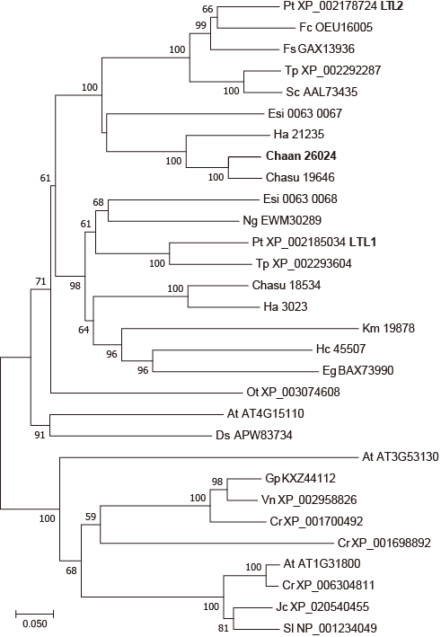
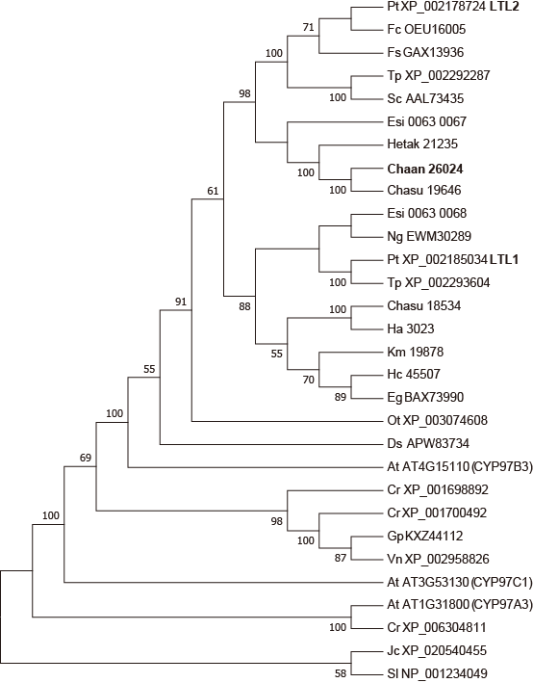
Fig. S11 The most parsimony phylogenetic tree (a) and Neighbor-Joining (b) of the cytochrome P450 monooxygenase (CYP97 type).
(a)
(b)

Slide 12
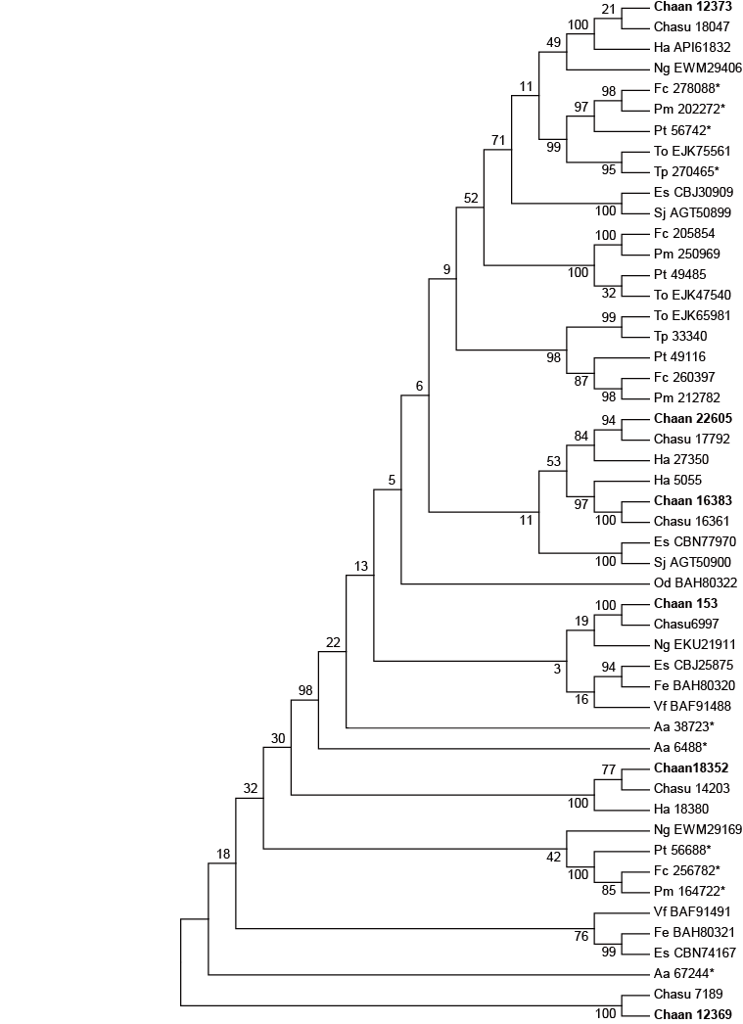
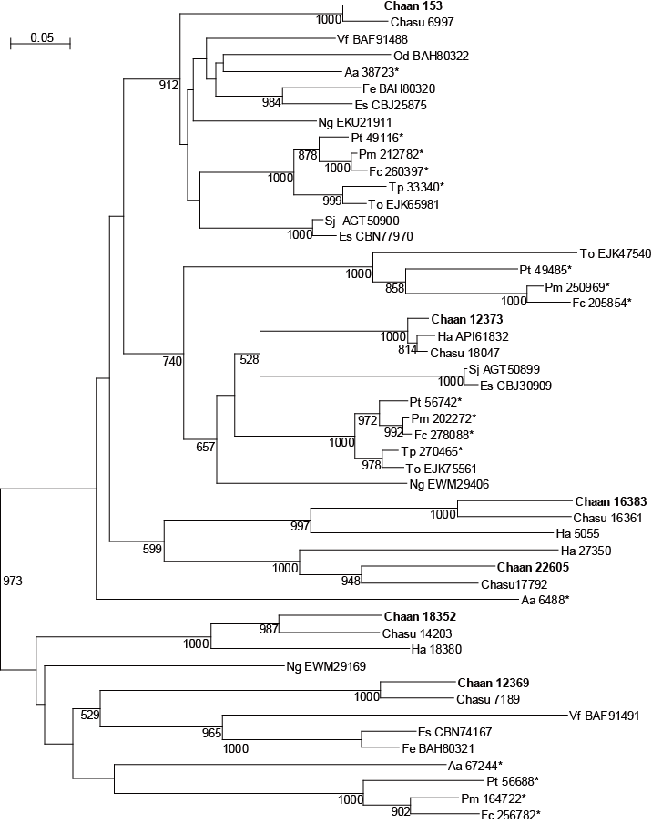
Fig. S12 The most parsimony phylogenetic tree (a) and Neighbor-Joining (b) of aureochrome.
(a)
(b)

Slide 13
Fig. S13-1 The maximum-likelihood phylogenetic tree of photolyase/cryptochrome family including red-tide flagellates other than Chattonella antiqua.
Cry-dash
Animal Cry
6-4 Phr
CPD class1
Plant Cry
CPD class3
CPD class2

Slide 14
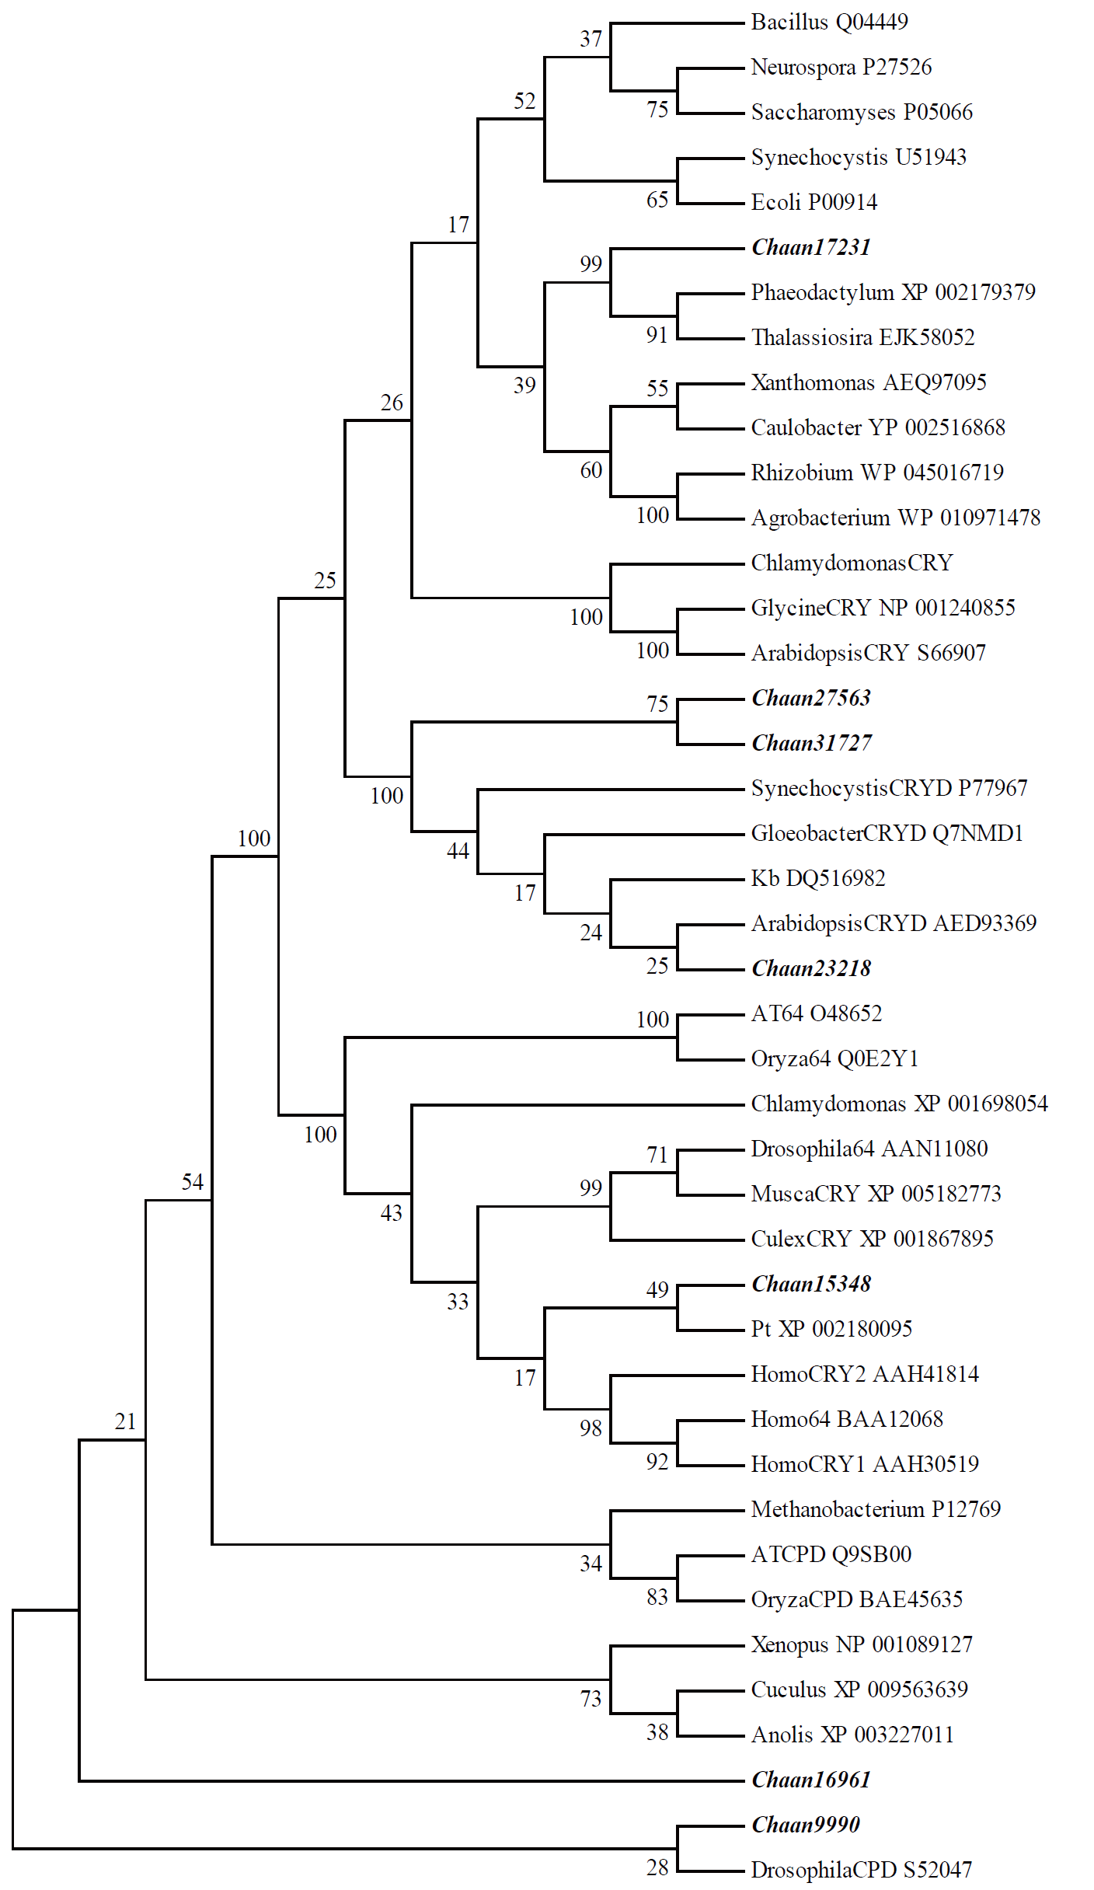
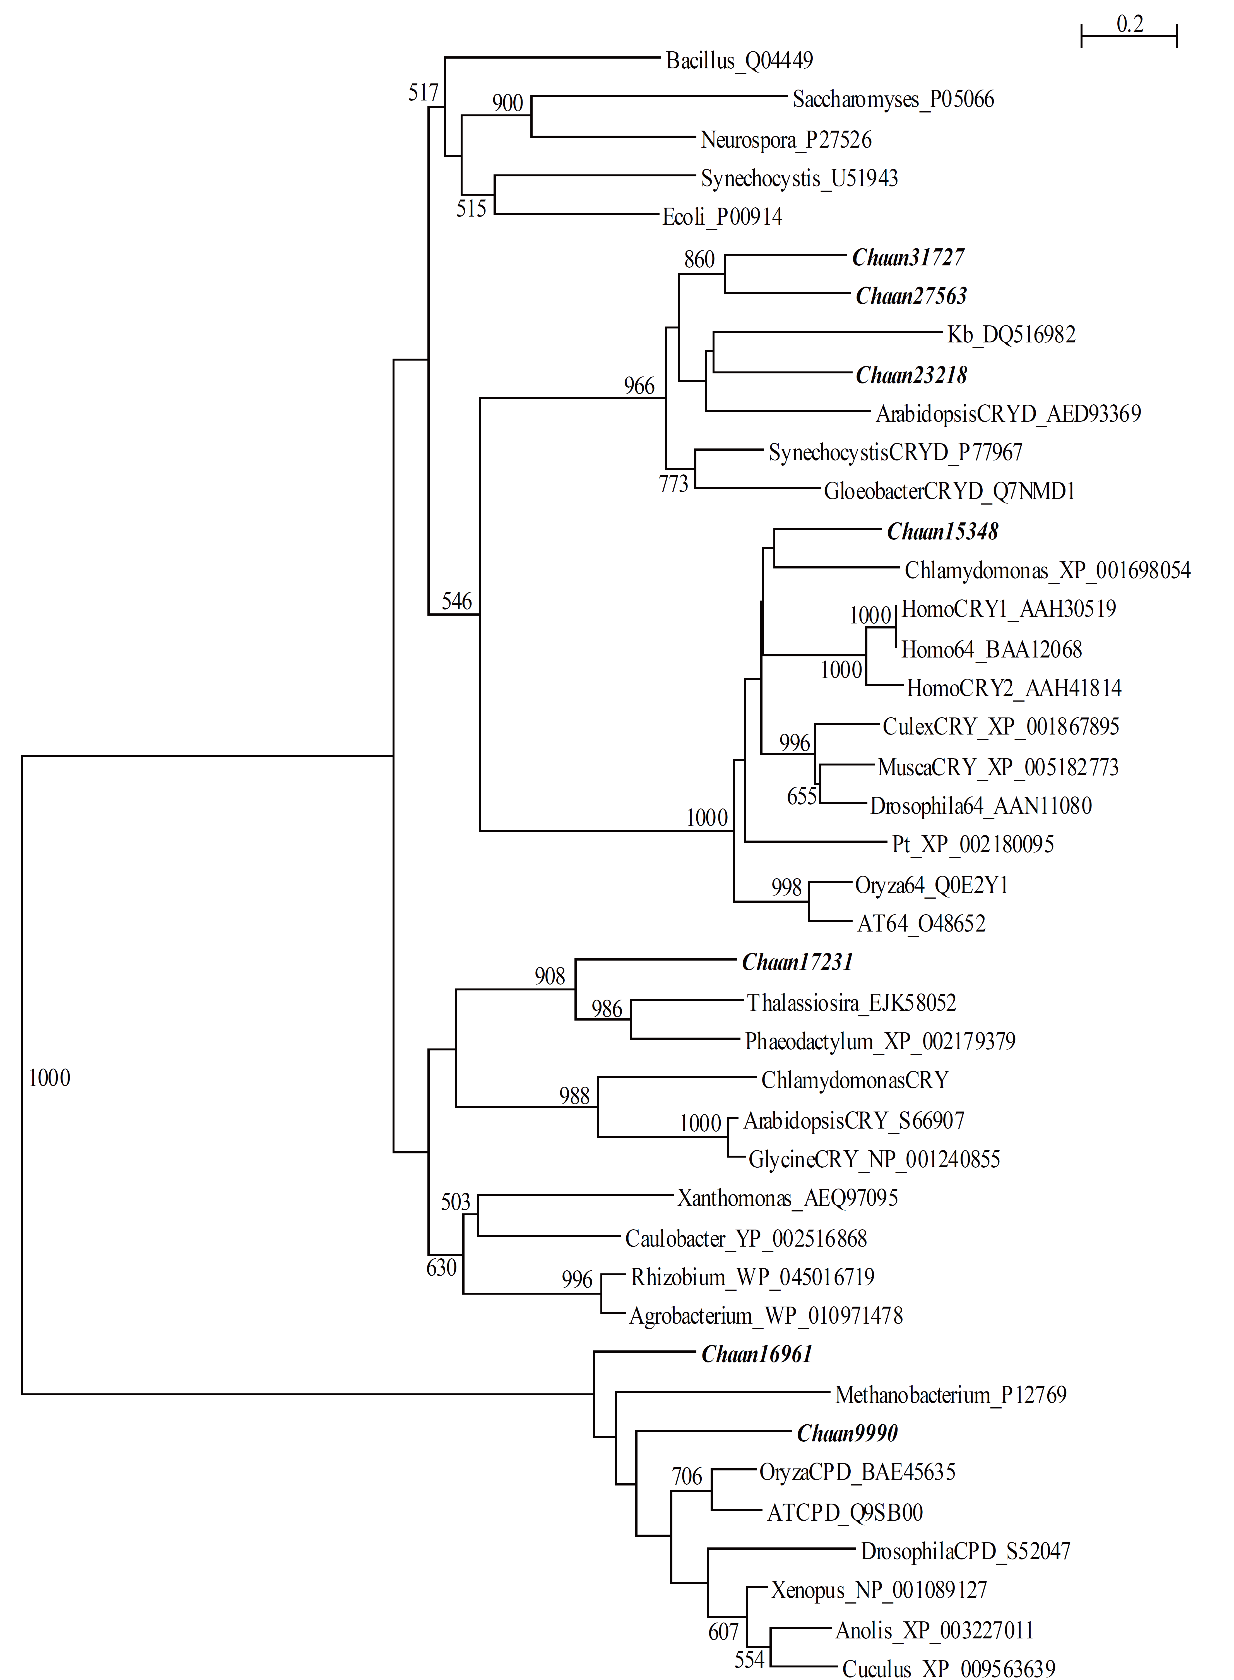
Fig. S13-2 The most parsimony phylogenetic tree (a) and Neighbor-Joining (b) of photolyase/cryptochrome family.
(a)
(b)

Slide 15
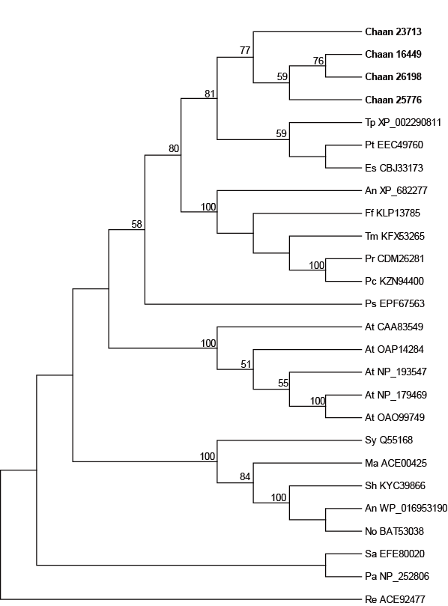
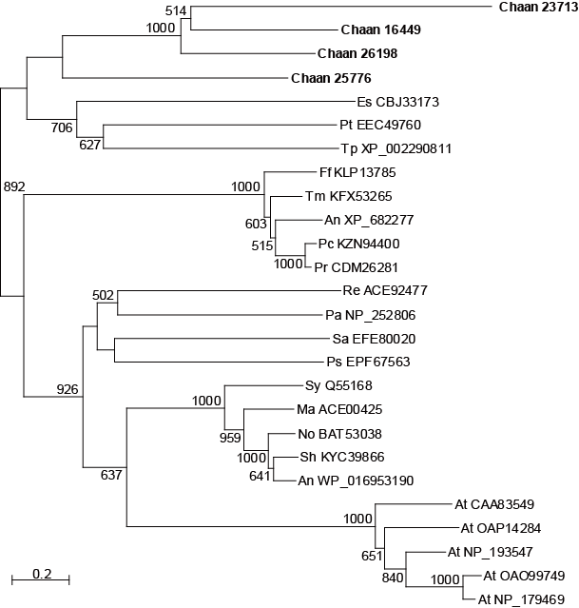
Fig. S14 The most parsimony phylogenetic tree (a) and Neighbor-Joining (b) of phytochrome.
a)
b)

Slide 16
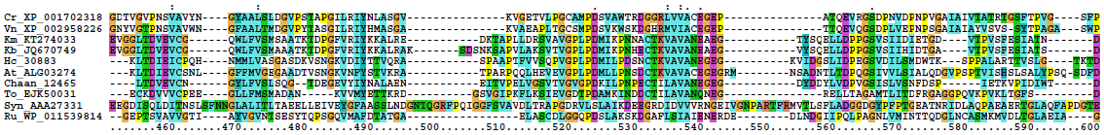
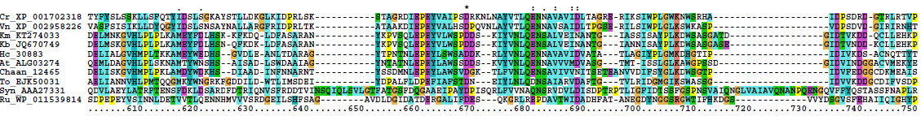
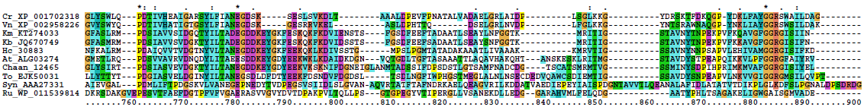
Fig. S15 Multi-sequence alignment of alkaline phosphatase gene.
Motif 1
Motif 2
Motif 3
Motif 4

Slide 17
Fig. S16 The most parsimony phylogenetic tree (a) and Neighbor-Joining (b) of alkaline phosphatase gene.
a)
b)

Slide 18
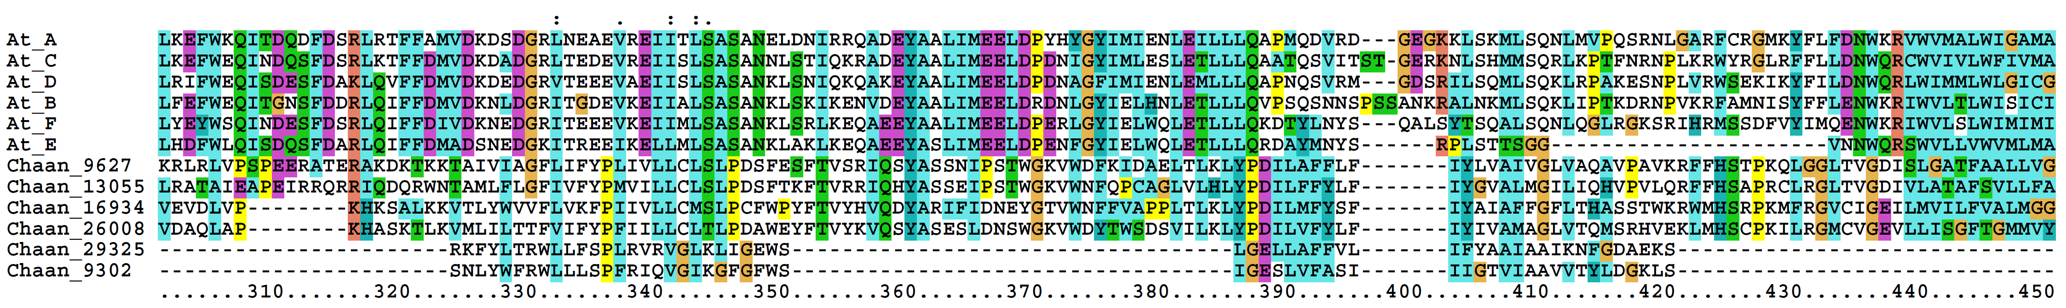
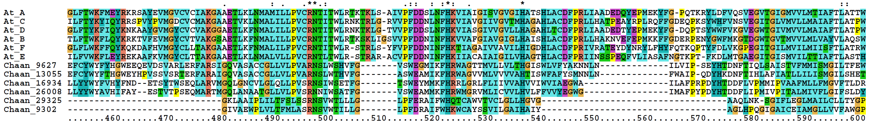
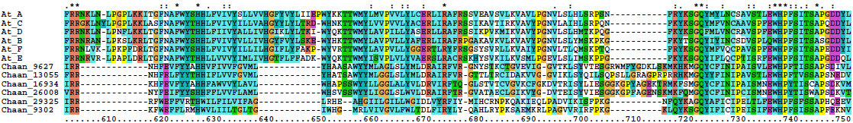
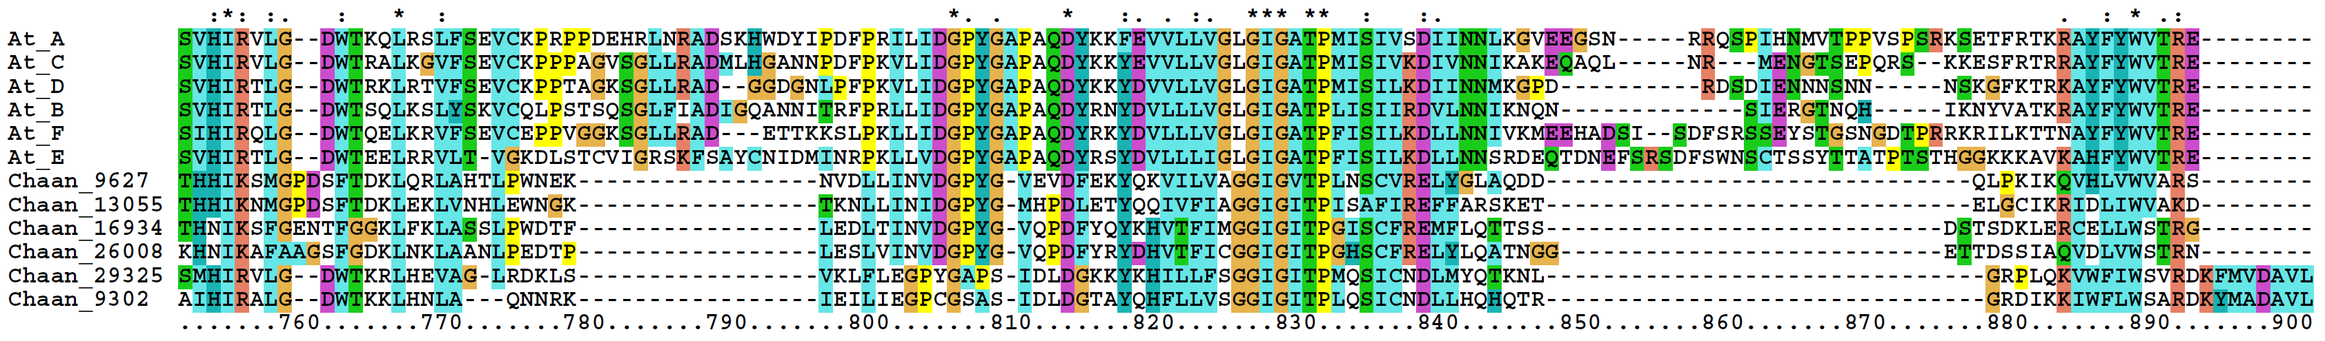
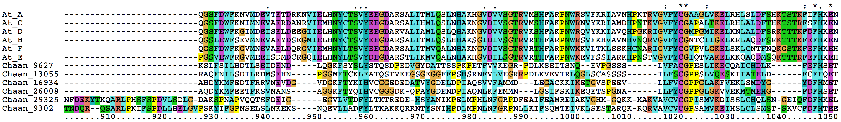
Fig. S17 Multi-sequence alignment of NOX gene. (A) EF-hand, (B)FAD-isoalloxazine binding site, (C) motif 2, (D) NADPH-ribulose binding site, and (E) NADPH binding site
(A)
(A)
(Ｂ)
(C)
(D)
(E)

Slide 19
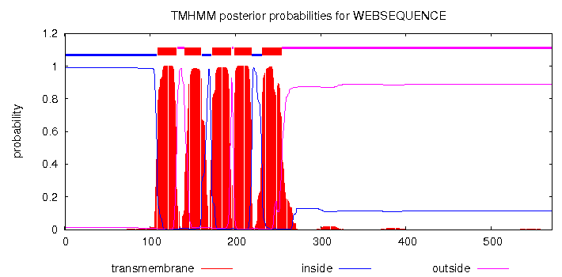
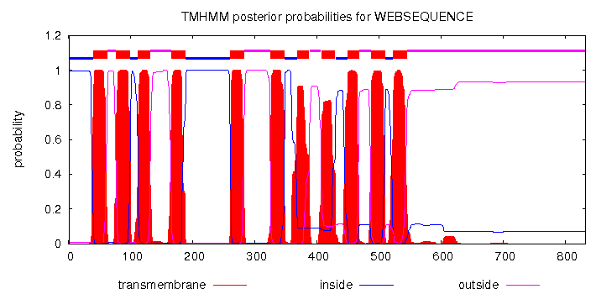
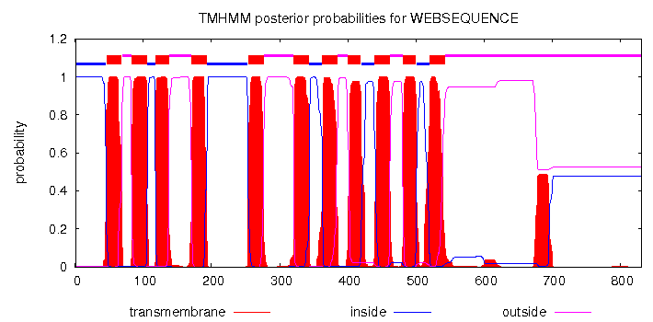
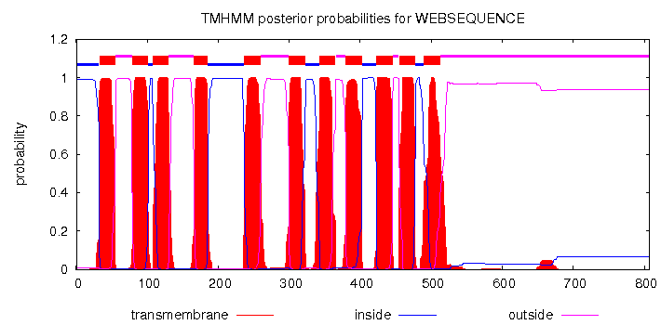
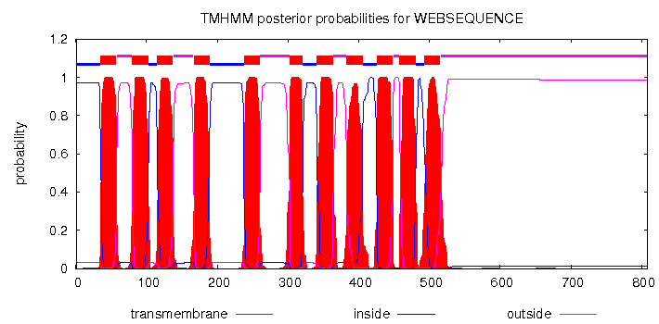
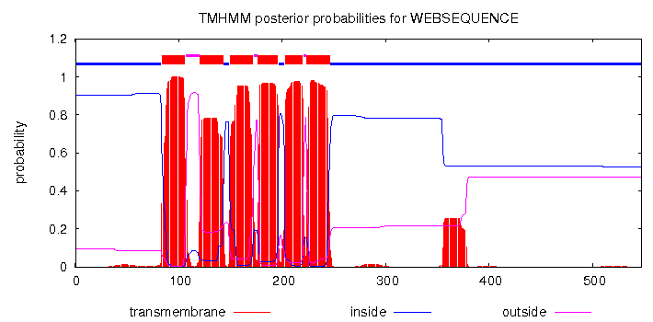
Fig. S18 Locations of transmembranes in Chattonella antiqua NOX, predicted by TMHMM Server v. 2.0.
Chaan9302
Chaan9627
Chaan13055
Chaan16934
Chaan26008
Chaan29325

