Slide 1
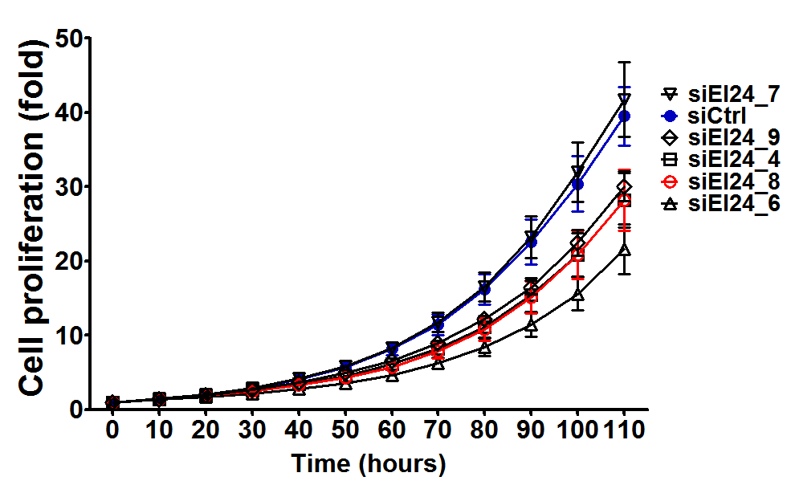
A
B
kDa
Ctrl
#4
#6
#7
#8
#9
siRNA
Ctrl
#4
#6
#7
#8
#9
siRNA
50
β-actin
EI24
36
36
EI24
GAPDH
16
LC3 II
C
Supplementary Figure S1. Selection of siRNA against EI24
MIA PaCa-2 cells were transfected with 10 nM siRNAs against control (Ctrl) or EI24 (#4, #6, #7, #8 and #9). (A) After 48 h of transfection, the mRNA level of EI24 and GAPDH were analyzed by reverse-transcript PCR. (B) The protein level of β-actin, EI24 and LC3 were analyzed by western blotting. (C) After 24 h of transfection, cells were reseeded into 96-well plate as triplicate and analyzed cell confluency using IncuCyte instrument and ZEN2016 program.

Slide 2
siCtrl
siEI24
siATG5
ATG5/Hoech
MIA PaCa2
Panc1
Supplementary Figure S2. ATG5 protein expression level after siATG5 transfection
MIA PaCa-2 and Panc-1 cells were transfected with 10 nM siRNA against control (Ctrl), EI24 and ATG5 for 48 h. ATG5 protein expression was observed by immunofluorescence staining using anti-ATG5 antibody. (Green : ATG5 and Blue (Hoechst 33342) : nucleus)

Slide 3
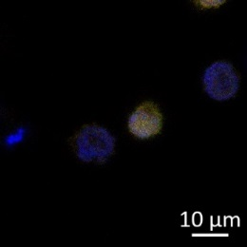
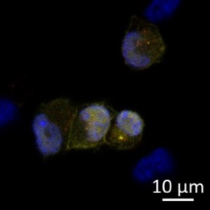
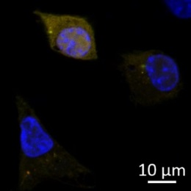
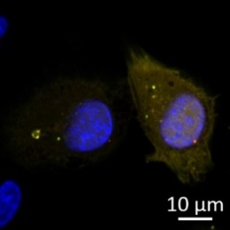
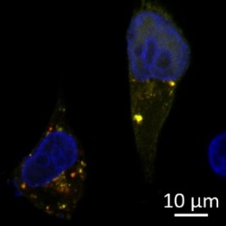
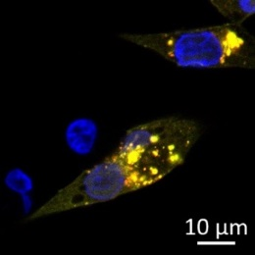
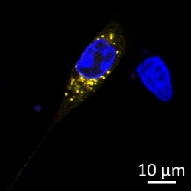
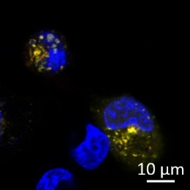
MIA PaCa-2
Panc-1
siCtrl
siCtrl
siEI24
siEI24
Supplementary Figure S3. RFP-GFP-LC3 transfection to EI24 knockdowned cells.
MIA PaCa-2 and Panc-1 cells were transfected with 10 nM siRNA against control (Ctrl) and EI24. After 48 h the first round of transfection, cells were retransfected with 10 nM siCtrl or siEI24 in combination with 1 μg of pcDNA3-RFP-GFP-LC3 plasmid. After 24 h of retransfection, cells were fixed with 3.7% formalin, stained with Hoechst33342 and observed with a confocal microscope. (Blue (Hoechst 33342) : nucleus, Yellow (RFP(+)-GFP(+)-LC3) : autophagosome, Red (RFP(+)-GFP(-)-LC3) : autolysosome)

Slide 4
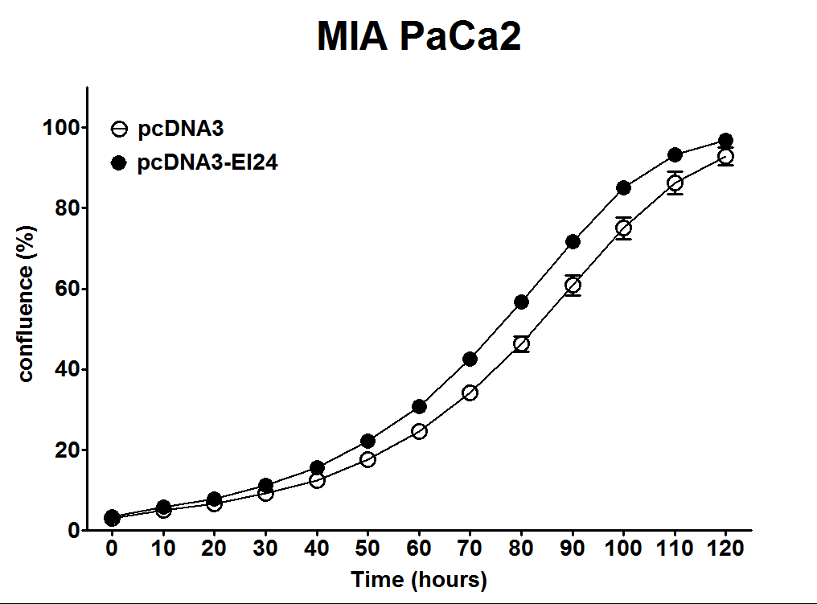
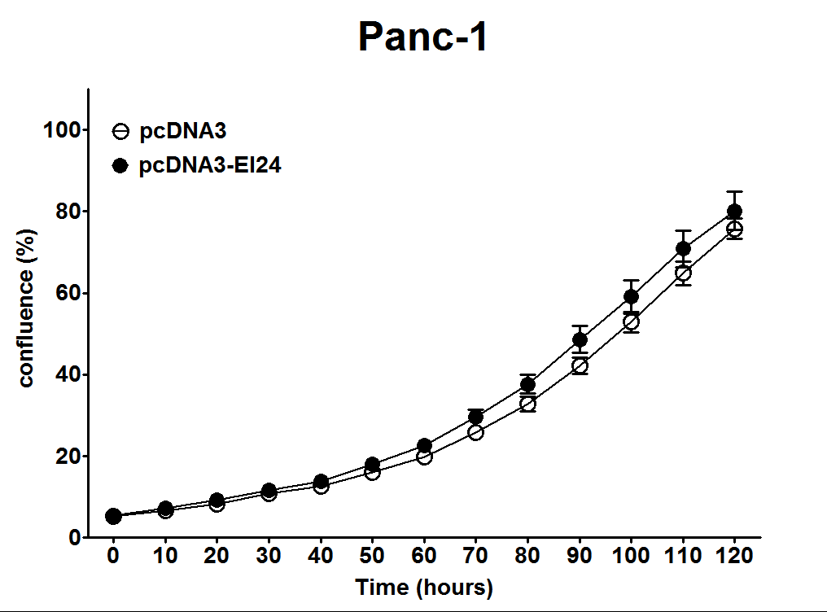
A
B
MIA PaCa-2
Panc-1
+
-
+
-
pcDNA
-
+
-
+
kDa
pcDNA-EI24
40
flag-EI24
16
LC3 II
60
p62
50
β-actin
40
Supplementary Figure S4. Overexpression of EI24 in Pancreatic cancer cells
(A) MIA PaCa-2 and Panc-1 cells (1 X 10⁵ cells) were transfected with 0.5 μg of pcDNA3 and pcDNA3-EI24. After 24 hr transfection, cells were reseeded on 96 well plate as triplicate and analyzed confluency at the indicated time using IncuCyte instrument and ZEN2016 program. (B) The protein level of β-actin, EI24-flag, LC3 and p62 were analyzed by western blotting.

Slide 5
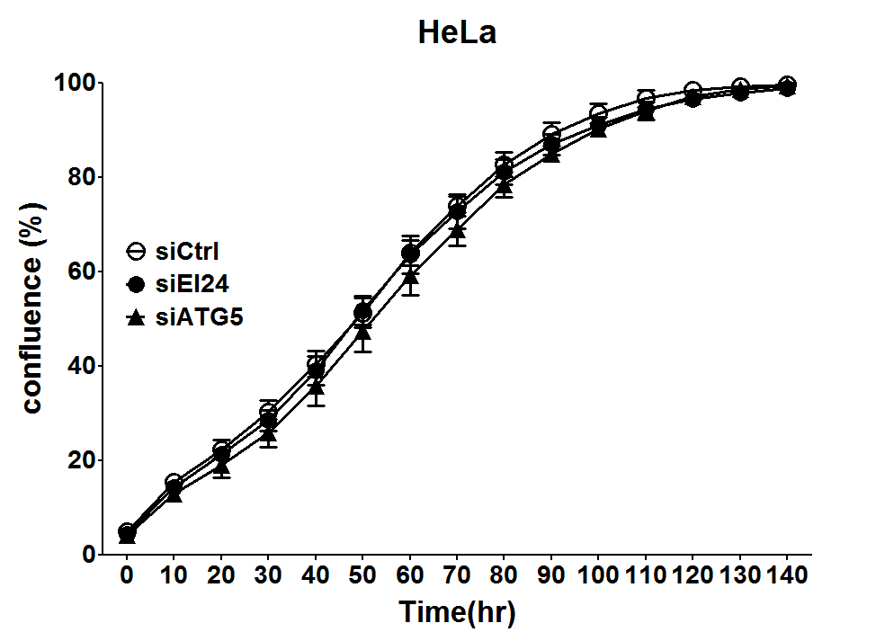
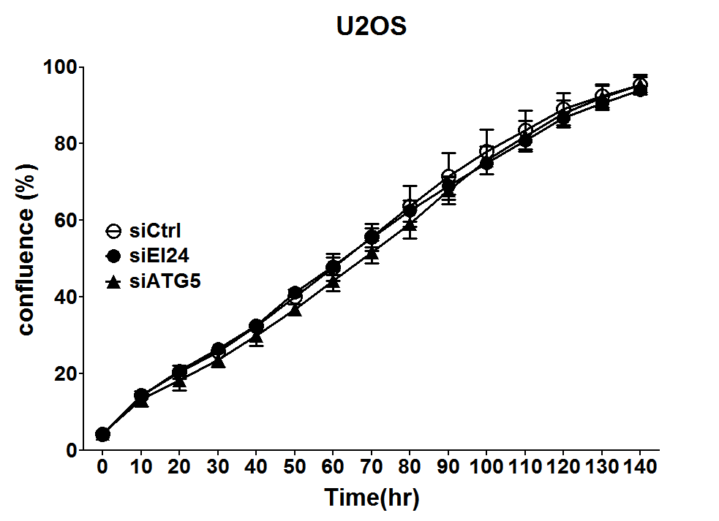
A
B
HeLa
U2OS
kDa
Ctrl
EI24
ATG5
siRNA
kDa
Ctrl
EI24
ATG5
siRNA
36
Ei24
36
Ei24
64
ATG5
64
ATG5
16
LC3
16
LC3
LC3 II
LC3 II
64
p62
64
p62
50
β-actin
50
β-actin
Supplementary Figure S5. Loss of EI24 in cell proliferation of HeLa and U2OS.
HeLa and U2OS cells were transfected with 10 nM siRNA against control (Ctrl), EI24 and ATG5. (A) After 24 h of transfection, cells were reseeded into 96 well plate as triplicate and analyzed confluency at the indicated time using IncuCyte instrument and ZEN2016 program. (B) The protein level of β-actin, EI24, ATG5, LC3 and p62 were analyzed by western blotting.

