Slide 1
Cancer Cell Targeting with Functionalized Quantum Dot -Encoded Polyelectrolyte Microcapsules
Galina Nifontova¹, Fernanda Ramos-Gomes², Maria Baryshnikova^{1,3}, Frauke Alves^{2,4}, Igor Nabiev^{1,5, *}, and Alyona Sukhanova^{1,5, *}
¹ Laboratory of Nano-Bioengineering, National Research Nuclear University MEPhI (Moscow Engineering Physics Institute), Kashirskoye Shosse, 31, 115409 Moscow, Russian Federation
² Translational Molecular Imaging, Max-Planck-Institute of Experimental Medicine, Hermann-Rein-Str. 3, 37075 Göttingen, Germany
³ Institute of Experimental Diagnostic and Biotherapy, N.N. Blokhin National Medical Research Center of Oncology, Ministry of Health of the Russian Federation, Kashirskoye Shosse, 24, 115478 Moscow, Russian Federation
⁴ Clinic of Haematology and Medical Oncology, University Medical Center Göttingen, Robert-Koch-Str. 40, 37075 Göttingen, Germany.
⁵ Laboratoire de Recherche en Nanosciences (LRN-EA4682), Université de Reims Champagne-Ardenne, rue Cognacq Jay, 51, 51100 Reims, France
⃰ Correspondence
Prof. Igor Nabiev, e-mail: igor.nabiev@gmail.com, or Dr. Alyona Sukhanova, e-mail: alyona.sukhanova@univ-reims.fr
Keywords: quantum dots, polyelectrolyte microcapsules, monoclonal antibody, cytotoxicity, cancer cell targeting

Slide 2
The capacity of the conjugates for specific interaction with HER2-expressing cells
FIGURE S1 Size distribution of the CT(PEG)₁₂-solubilized CdSe/ZnS QDs determined by dynamic light scattering using Zetaszer NanoZS (Malvern, UK).

Slide 3
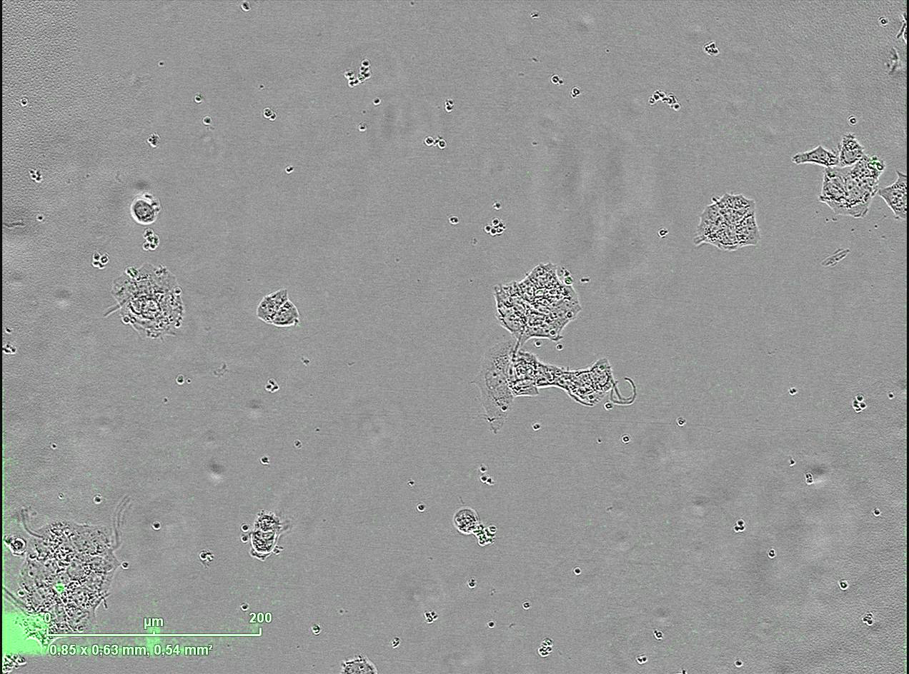
The capacity of the conjugates for specific interaction with HER2-expressing cells
VIDEO S1 Interaction and binding of the QD-encoded microcapsules conjugated with 3 µg anti-HER2 mABs on their surface. The quantity of microcapsules per cell was 50. The video was recorded after 12 h of exposition of the microcapsules to living BT-474 cells, using 20x objective.

Slide 4
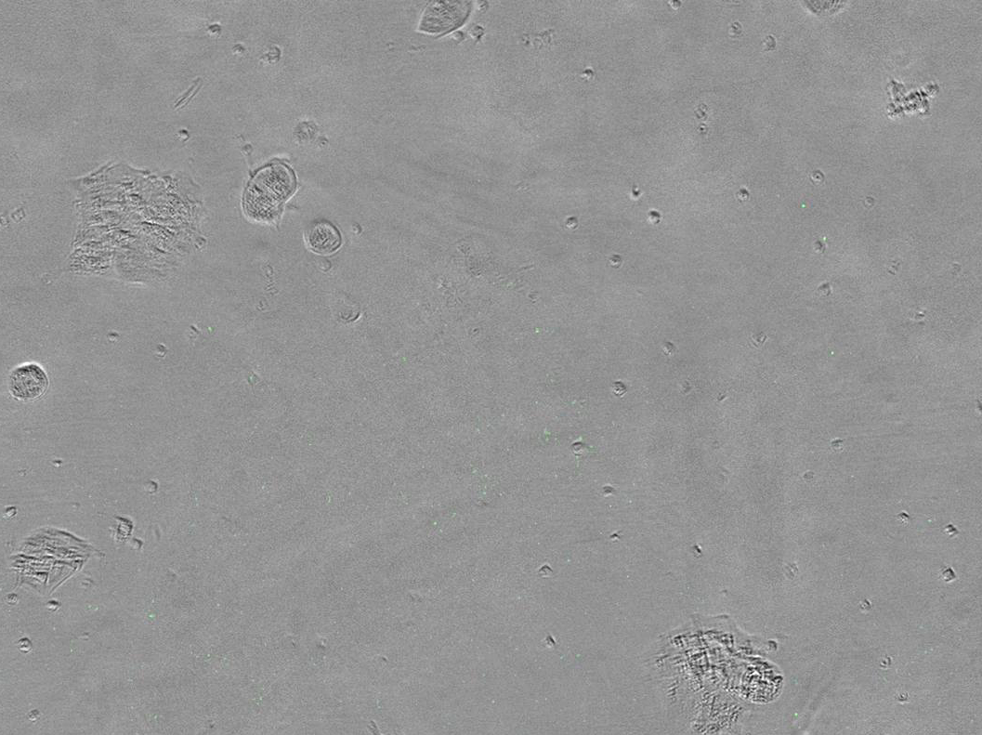
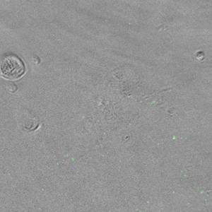
The capacity of the conjugates for specific interaction with HER2-expressing cells
VIDEO S2 Interaction and binding of the QD-encoded microcapsules conjugated with 30µg anti-HER2 mABs on their surface. The quantity of microcapsules per cell was 50 . The video was recorded at 12 after of exposition of the microcapsules to living BT-474 cells, using 20x objective.

Slide 5
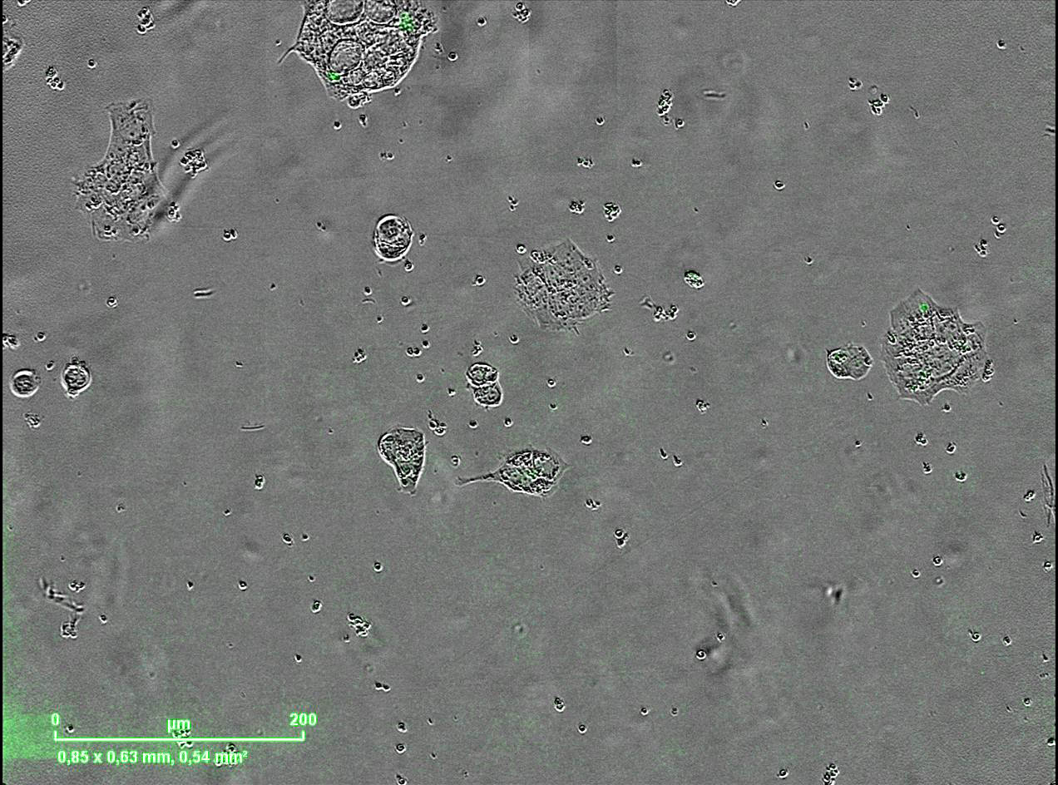
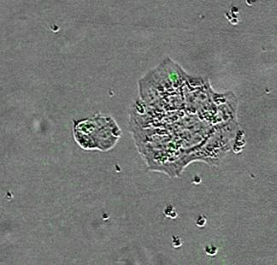
The capacity of the conjugates for specific interaction with HER2-expressing cells
VIDEO S3 Interaction and binding of the QD-encoded microcapsules conjugated with 300 µg anti-HER2 mABs on their surface. The quantity of microcapsules per cell was 50 . The video was recorded after 12 h of exposition of the microcapsules to living BT-474 cells, using 20x objective.

