Slide 1
Supplementary Figure S1. Feng et al.
Reciprocal titer

Slide 2
Supplementary Figure S2. Feng et al.

Slide 3
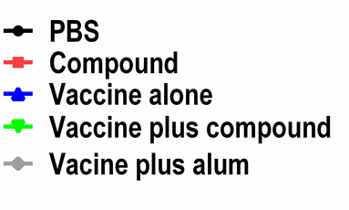
Supplementary Figure S2. Feng et al. – continued

