Slide 1
Figure S1
Notes:
Figure S1. Comparison chemical structures of (E)-2-[(3-Amino-pyridin-4-ylimino)-methyl]-4,6-difluoro-phenol (F1), (E)-2-[(3-Amino-pyridin-4-ylimino)-methyl]-6-fluoro-phenol (F2), (E)-2-{[(3-aminopyridin-4-yl)imino]-methyl}-4,6-di-chloro-phenol (L3) (Carreño et al., 2018b), and (E)-2-{[(3-aminopyridin-4-yl)imino]-methyl}-6-chloro-phenol (L4) (Carreño et al., 2018b)

Slide 2
Figure S2
Notes:
Figure S2. Mass spectra of F1.

Slide 3
Figure S3
Notes:
Figure S3. Mass spectra of F2.

Slide 4
Figure S4
Notes:
Figure S4. FTIR spectra of F1.

Slide 5
Figure S5
Notes:
Figure S5. FTIR spectra of F2.

Slide 6
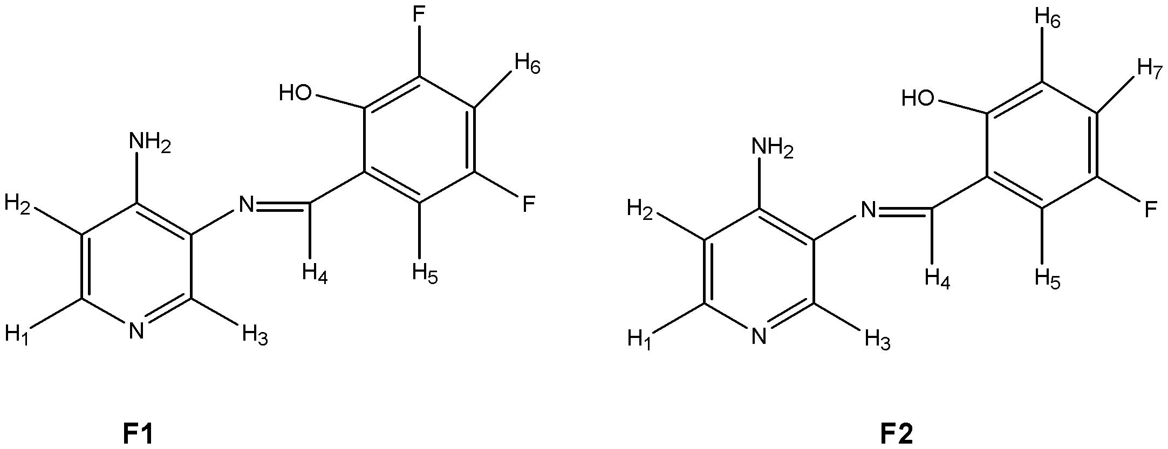
Figure S6
Notes:
Figure S6. Numbering of proton used in the ¹HNMR study of F1 and F2.

Slide 7
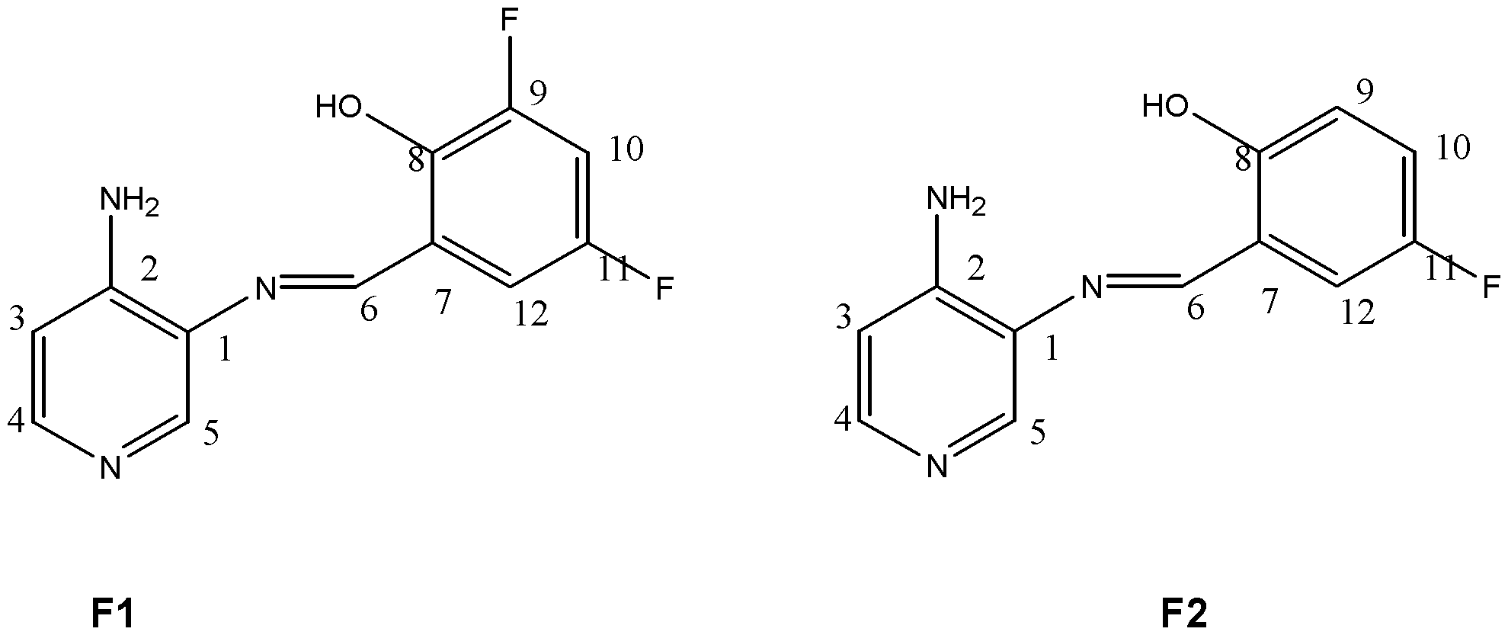
Figure S7
Notes:
Figure S7. Numbering of carbons used in the ¹³CNMR study of F1 and F2.

Slide 8
Figure S8
Notes:
Figure S8. ¹HNMR spectra of F1 in DMSO-_{d6}.

Slide 9
Figure S9
Notes:
Figure S9. Aromatic expanded region of ¹HNMR spectra of F1 in DMSO-_{d6}.

Slide 10
Figure S10
Notes:
Figure S10. ¹HNMR spectra of F2 in DMSO-_{d6}.

Slide 11
Figure S11
Notes:
Figure S11. Aromatic expanded region of ¹HNMR spectra of F2 in DMSO-_{d6}.

Slide 12
Figure S12
Notes:
Figure S12. Aromatic expanded region of D₂O exchange ¹HNMR spectra of F1 in DMSO-_{d6}.

Slide 13
Figure S13
Notes:
Figure S13. Aromatic expanded region of D₂O exchange ¹HNMR spectra of F2 in DMSO-_{d6}.

Slide 14
Figure S14
Notes:
Figure S14. 2D HHCOSY spectrum of F1.

Slide 15
Figure S15
Notes:
Figure S15. 2D HHCOSY spectrum of F2.

Slide 16
Figure S16
Notes:
Figure S16. 1D TOCSY for H5 of F1 in DMSO-_{d6}, irradiating at 2989.27 Hz spectrum.

Slide 17
Figure S17
Notes:
Figure S17. 1D TOCSY for H6 of F1 in DMSO-_{d6}, irradiating at 3013.92 Hz spectrum.

Slide 18
Figure S18
Notes:
Figure S18. 1D TOCSY for H1 of F1 in DMSO-_{d6}, irradiating at 3183.68 Hz spectrum.

Slide 19
Figure S19
Notes:
Figure S19. 1D TOCSY for H2 of F1 in DMSO-_{d6}, irradiating at 2665.87 Hz spectrum.

Slide 20
Figure S20
Notes:
Figure S20. 1D TOCSY for H5 of F2 in DMSO-_{d6}, irradiating at 3075.66 Hz spectrum.

Slide 21
Figure S21
Notes:
Figure S21. 1D TOCSY for H7 of F2 in DMSO-_{d6}, irradiating at 2925.70 Hz spectrum.

Slide 22
Figure S22
Notes:
Figure S22. 1D TOCSY for H2 of F2 in DMSO-_{d6}, irradiating at 2681.66 Hz spectrum.

Slide 23
Figure S23
Notes:
Figure S23. ¹³CNMR spectra of F1 in DMSO-_{d6}.

Slide 24
Figure S24
Notes:
Figure S24. ¹³CNMR spectra of F2 in DMSO-_{d6}.

Slide 25
Figure S25
Notes:
Figure S25. DEPT spectra of F1 in DMSO-_{d6}.

Slide 26
Figure S26
Notes:
Figure S26. DEPT spectra of F2 in DMSO-_{d6}.

Slide 27
Figure S27
Notes:
Figure S27. ¹⁹FNMR spectra of F1 in DMSO-_{d6}.

Slide 28
Figure S28
Notes:
Figure S28. ¹⁹FNMR spectra of F2 in DMSO-_{d6}.

Slide 29
Figure S29
Notes:
Figure S29. UV-vis spectra of F1 in dichloromethane (ε = 8.93) as solvent. A stock solution of F1 in DMSO (1.25×10⁻³ mol/L) was prepared, prior being diluted in dichloromethane (2 mL). Lines indicate the volume of the stock solution of F1 added to dichlorometane.

Slide 30
Figure S30
Notes:
Figure S30. UV-vis spectra of F1 in acetonitrile (ε = 37.5) as solvent. A stock solution of F1 in DMSO (1.25×10⁻³ mol/L) was prepared, prior being diluted in acetonitrile (2 mL). Lines indicate the volume of the stock solution (F1) added to acetonitrile.

Slide 31
Figure S31
Notes:
Figure S31. UV-vis spectra of F1 in DMSO (ε = 46.7) as solvent. A stock solution of F1 in DMSO (1.25×10⁻³ mol/L) was prepared, prior being diluted in DMSO (2 mL). Lines indicate the volume of the stock solution (F1) added to DMSO.

Slide 32
Figure S32
Notes:
Figure S32. UV-vis spectra of F2 in dichloromethane (ε = 8.93) as solvent. A stock solution of F2 in DMSO (1.25×10⁻³ mol/L) was prepared, prior being diluted in dichloromethane (2 mL). Lines indicate the volume of the stock solution (F1) added to dichloromethane.

Slide 33
Figure S33
Notes:
Figure S33. UV-vis spectra of F2 in acetonitrile (ε = 37.5) as solvent. A stock solution of F2 in DMSO (1.25×10⁻³ mol/L) was prepared, prior being diluted in acetonitrile (2 mL). Lines indicate the volume of the stock solution (F1) added to acetonitrile.

Slide 34
Figure S34
Notes:
Figure S34. UV-vis spectra of F2 in DMSO (ε = 46.7) as solvent. A stock solution of F2 in DMSO (1.25×10⁻³ mol/L) was prepared, prior being diluted in DMSO (2 mL). Lines indicate the volume of the stock solution (F1) added to DMSO.

Slide 35
Figure S35
Notes:
Figure S35. Computed FTIR spectra for F1.

Slide 36
Figure S36
Notes:
Figure S36. Computed FTIR spectra for F2.

Slide 37
Figure S37
Notes:
Figure S37: Electrochemical working window study during cyclic voltammetry experiments for compounds. Interphase: Pt| 0.01 mol L⁻¹ of compound + 0.1 mol L⁻¹ of TBAPF₆ in anhydrous CH₃CN under an argon atmosphere. Scan rate: 200 mV s⁻¹.

Slide 38
Figure S38
Notes:
Figure S38. Electrochemical scan-rate study during cyclic voltammetry experiments of compounds. Interphase: Pt| 0.01 mol L⁻¹ of compound + 0.1 mol L⁻¹ of TBAPF₆ in anhydrous CH₃CN under an argon atmosphere. Scan rate is shown in the figure.

Slide 39
Figure S39
Notes:
Figure S39. Nitrogen adsorption isotherm for βF1, βF2, and βCD.

